Slide 1
Commercially Useful Function
& DBE Fraud Awareness
Erin Fragoso CRO Research Analyst

Slide 2
U.S. Department of Transportation
49 CFR 26.55:
(c) Count expenditures to a DBE contractor toward DBE goals only if the DBE is performing a commercially useful function on that contract.
(1) A DBE performs a commercially useful function when it is responsible for execution of the work of the contract and is carrying out its responsibilities by actually performing, managing, and supervising the work involved. To perform a commercially useful function, the DBE must also be responsible, with respect to materials and supplies used on the contract, for negotiating price, determining quality and quantity, ordering the material, and installing (where applicable) and paying for the material itself. To determine whether a DBE is performing a commercially useful function, you must evaluate the amount of work subcontracted, industry practices, whether the amount the firm is to be paid under the contract is commensurate with the work it is actually performing and the DBE credit claimed for its performance of the work, and other relevant factors.
(2) A DBE does not perform a commercially useful function if its role is limited to that of an extra participant in a transaction, contract, or project through which funds are passed in order to obtain the appearance of DBE participation. In determining whether a DBE is such an extra participant, you must examine similar transactions, particularly those in which DBEs do not participate.
(3) If a DBE does not perform or exercise responsibility for at least 30% of the total cost of its contract with its own work force, or the DBE subcontracts a greater portion of the work of a contract than would be expected on the basis of normal industry practice for the type of work involved, you must presume that it is not performing a commercially useful function.
(4) When a DBE is presumed not to be performing a commercially useful function as provided in paragraph (c)(3) of this section, the DBE may present evidence to rebut this presumption. You may determine that the firm is performing a commercially useful function given the type of work involved and normal industry practices.
(5) Your decisions on commercially useful function matters are subject to review by the concerned operating administration, but are not administratively appealable to DOT.
3/26/2021

Slide 3
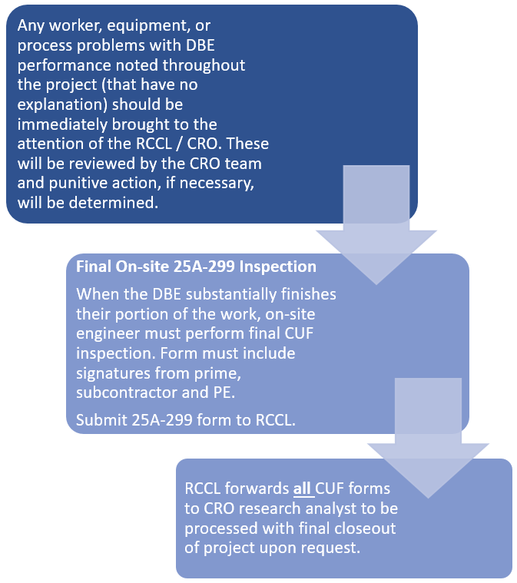
Overview of the Process

Slide 4
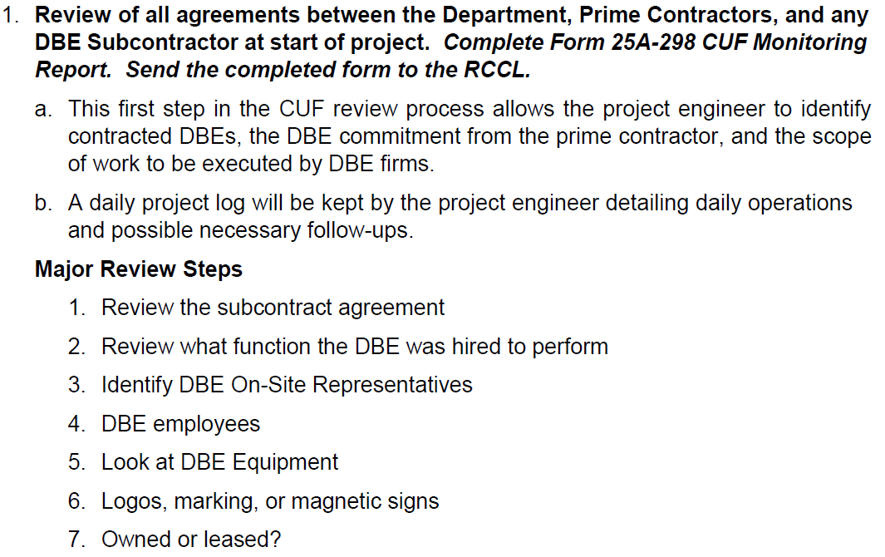
Overview of the Process
DBE Interview Steps:

Slide 5
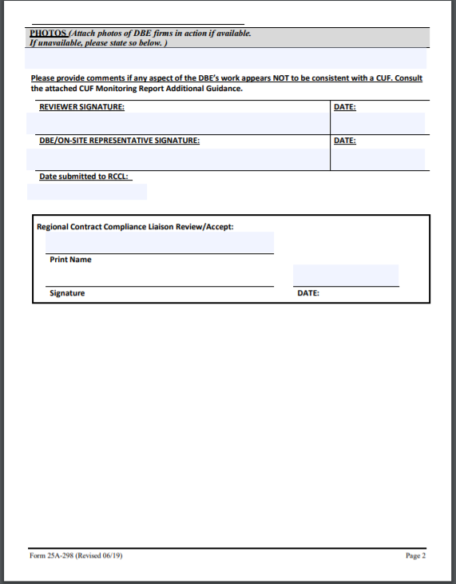
The CUF Forms

Slide 6
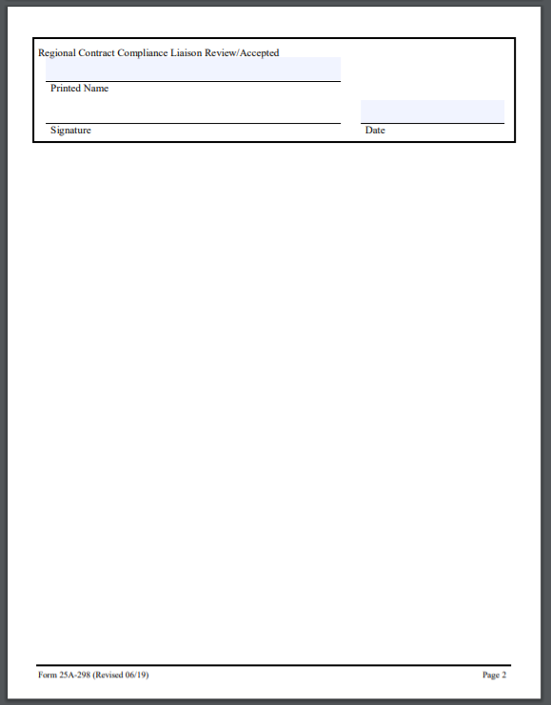
The CUF Forms

Slide 7
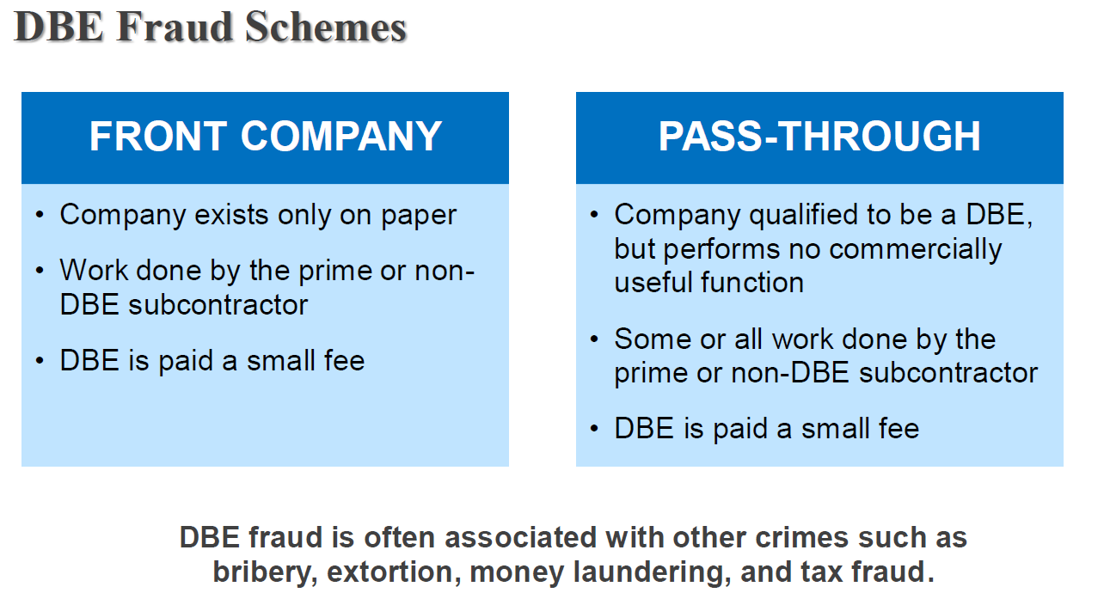
Importance of Performing CUFs
Avoid DBE Fraud
From ‘The Real Cost of DBE Fraud’ by Michelle McVicker:

Slide 8
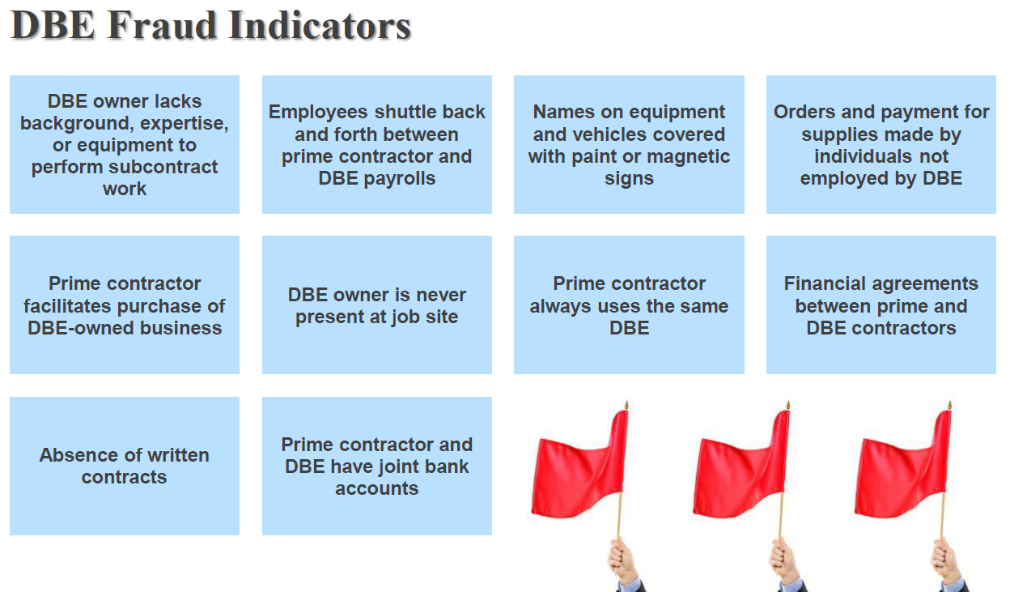
Importance of Performing CUFs
Avoid DBE Fraud
From ‘The Real Cost of DBE Fraud’ by Michelle McVicker:

Slide 9
Importance of Performing CUFs
Avoid DBE Fraud
From ‘The Real Cost of DBE Fraud’ by Michelle McVicker:

Slide 10
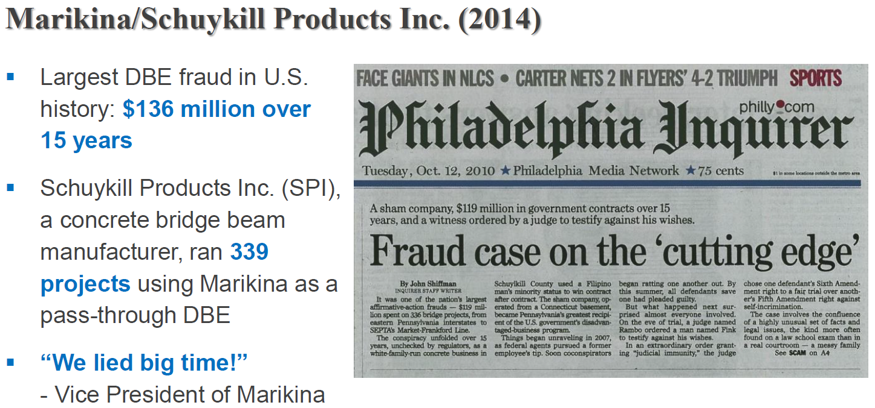
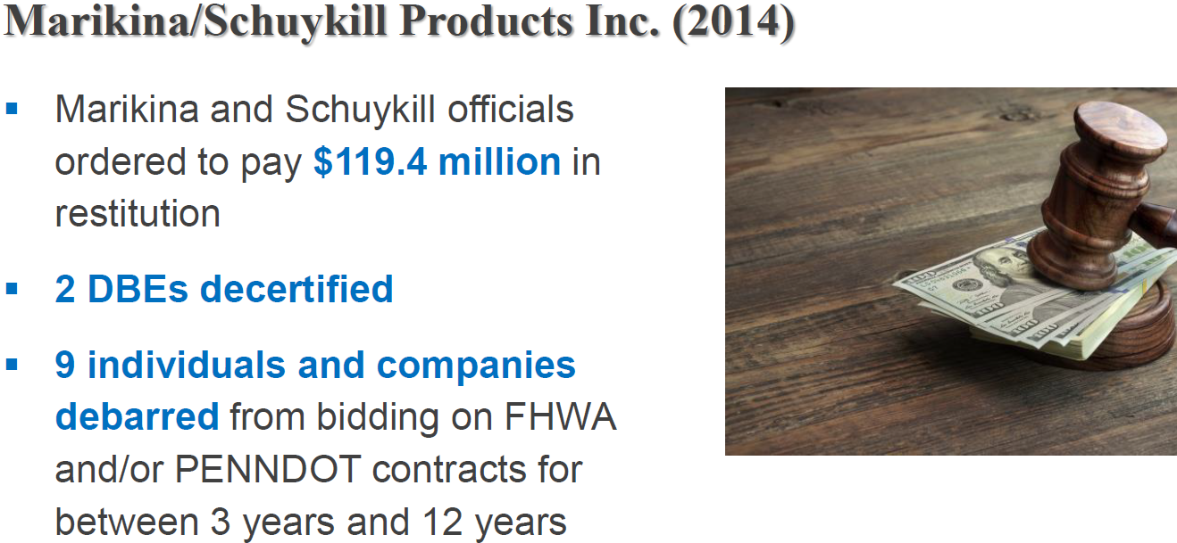
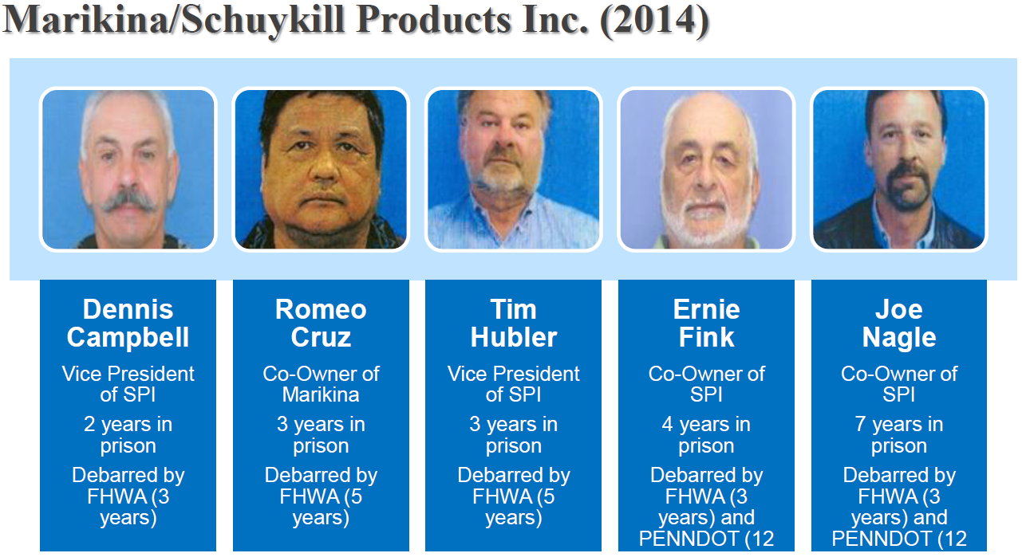
Importance of Performing CUFs
Avoid DBE Fraud
From ‘The Real Cost of DBE Fraud’ by Michelle McVicker:

Slide 11
CUF Operations & Red Flags
To determine whether a DBE subcontractor is performing a commercially useful function, five operations must be considered:
Management / Supervision
Workforce / Employees
Equipment
Materials / Supplies
Performance

Slide 12
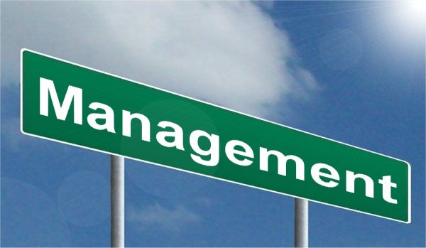
CUF Operations & Red Flags
Management
The DBE must manage the work that has been contracted to its firm. Management includes, but is not limited to:
Scheduling work operations
Ordering equipment and materials
Preparing and submitting certified payrolls
Hiring and firing employees
Making operational / managerial decisions
Supervision of daily operations
Red Flags:
DBE owner or superintendent provides little or no supervision of work
DBE superintendent is not a regular employee of the firm, or supervision is performed by personnel associated with the prime contractor or another business
Key staff and personnel are not under the DBE’s control
DBE owner is not aware of the status of the work or the performance of the business
DBE company owners rarely or never seen

Slide 13
CUF Operations & Red Flags
Workforce
In order to be considered an independent business, a DBE must keep a regular workforce. DBEs cannot share employees with non-DBE contractors, particularly the prime contractor. All work must be performed with a workforce that the DBE controls, with a minimum of 30% of the work to be performed by the DBE’s regular employees, or those hired by the DBE for the project from a source, such as a labor union. The DBE must have direct supervision over all of its employees.
The DBE must be responsible for payroll and labor compliance requirements for all employees performing on the contract, and is expected to prepare and finance the payrolls. Direct or indirect payments by any other contractor is not allowed. The DBE must perform at least 30% of the total cost of its contract with its own workforce. The DBE must not subcontract a greater portion of the work than would be expected on the basis of normal industry practice for the type of work involved.
Red Flags:
Supervision of DBE employees by another contractor
Employees are paid by the DBE and the prime contractor
Work is performed by personnel normally employed by the prime contractor / another business

Slide 14
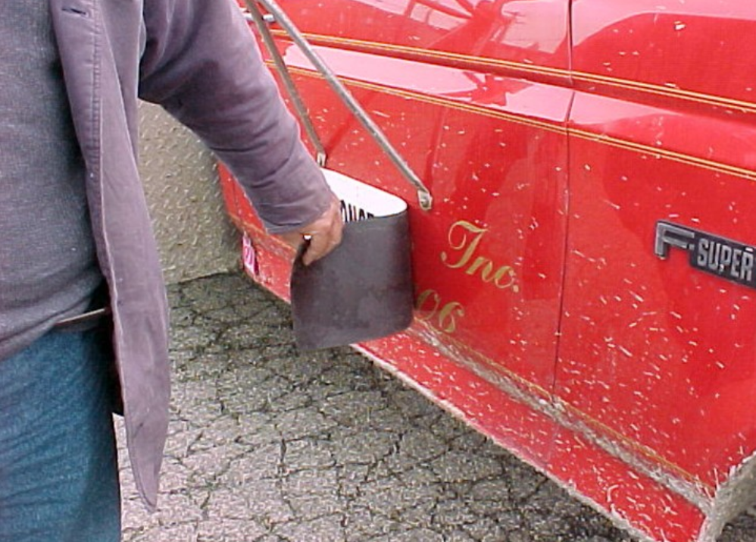
CUF Operations & Red Flags
Equipment
A DBE may lease specialized equipment from a contractor, excluding the prime, if it is consistent with normal industry practices and at competitive rates for the area. The lease must specify the terms of agreement, and it must be for a short period of time / involve a specialized piece of equipment to be used at the job site. The operation of the equipment must be subject to the full control of the DBE. The DBE is expected to provide the operator for non-specialized equipment and is responsible for all payroll and labor compliance requirements. A separate lease agreement is required, and all lease agreements should be approved by the State Transportation Authority (STA) prior to the DBE starting work.
On a case by case basis, the STA may approve the DBE to lease a specialized piece of equipment from the prime. The STA must ensure that the lease amount is not counted toward the contract goal. Equipment leased and used by the DBE with payment deducted from the prime contractor’s payments to the DBE is not allowed.
Red Flags:
DBE trucking business uses trucks owned by the prime
Equipment signs/markings cover another owner’s identity
DBE uses equipment owned by the prime or another
contractor with no lease agreement

Slide 15
CUF Operations & Red Flags
Materials
For a DBE contractor to receive credit for supplying materials, the DBE must perform the following four functions:
Negotiate price
Determine quality and quantity
Order the materials
Pay for the materials
If the DBE does not perform all of these functions, it has not performed a CUF with respect to obtaining the materials, and the cost of the materials may not be counted toward the DBE goal. Invoices for the materials should show the DBE paid for them.
Red Flags:
DBE materials are ordered and/or paid for by prime
Payment for materials is deducted by prime from
payments to the DBE for work performed
Materials necessary for DBE to perform are delivered,
billed, and/or paid by another business
Two party or joint checks are sent by the prime to the
supplier rather than being sent by the DBE

Slide 16
CUF Operations & Red Flags
Performance
The DBE must be responsible for the performance, management, and supervision of a distinct element of the work, in accordance with normal industry practice (except where such practices are inconsistent with the DBE regulations).
Red Flags:
Work is done jointly by DBE and another contractor
Work to be performed by DBE is outside of the DBE’s
known experience or capacity
Any portion of work designated to DBE is performed by
the prime or another contractor
The volume of work is beyond the capacity of the DBE
The agreement between the prime and DBE artificially
inflates the DBE’s participation
DBE is working without a subcontract approved by the
department (except in trucking)
An agreement erodes the ownership, control, or independence of the DBE
A DBE only works for one prime contractor or has a large portion of contracts with that prime

Slide 17
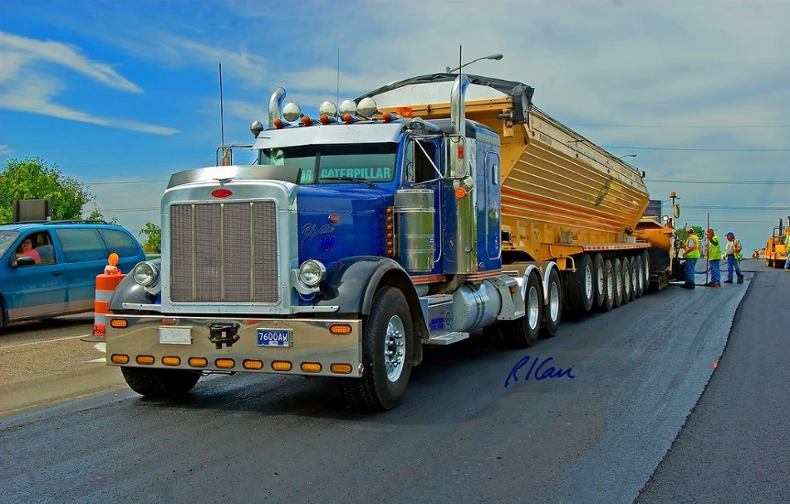
DBE Trucking Firms
Notes on DBE Trucking Firms
To be certified in the DBE program as a trucking firm, the DBE must own and operate at least one fully licensed, insured and operational truck used on the contract.
For the purposes of performing a CUF, the DBE must also be responsible for the management and supervision of the entire trucking operation, or a specified portion of the trucking operation to which it was been committed.
A DBE can supplement its fleet by leasing a truck(s) from an established equipment leasing business open to the general public.
Leased trucks must display the name and identification number of the DBE
The DBE trucker must hold necessary (where appropriate) license, hauling permit, etc. as required by the State to transport material on public highways.
In order for the STA or subrecipient to monitor the
performance of a DBE trucking firm, the work to be
performed must be covered by a subcontract approved
by the STA prior to performing the work. Additional
documentation required when the DBE leases
equipment is a valid lease to be provided to the STA for
appropriate action. Lease must include lessor’s name,
list of trucks to be leased by VIN, and agreed upon amount of the cost and method of payment. DBE
must be responsible for providing operator’s fuel, maintenance and insurance for all leased trucks.

Slide 18
DBE Trucking Firms
Notes on DBE Trucking Firms cont.
To count the value of DBE trucking services toward a contract goal, the following can occur:
The DBE may lease trucks from another DBE, including an owner-operator that is certified as a DBE. The DBE can count the entire value of services performed by these DBE trucks.
The DBE may also lease trucks from non-DBEs and owner-operators. The DBE can count the value of these trucking services up to the value of services performed by the DBE trucks used on the contract.
DBE participation can be counted for the value of services of non-DBE trucks that exceed the value of the services performed by DBE trucks only in the amount of the fee or commission a DBE receives as a result of the lease arrangement.
DBE Trucking Brokers
A DBE can act as a trucking firm, a trucking broker, or both on certain contracts.
DBE credit for a trucking firm = 100%
DBE credit for a trucking broker = 5%
If a DBE is operating as BOTH a trucking firm AND a trucking broker on a contract, then they receive 100% credit on the portion of the payment where they performed as a trucking firm, and they receive 5% credit on the portion of the payment where they acted as the trucking broker.
E.g. $200,000 is the payment for trucking work on a contract. If the firm did half of the work and then acted as the broker for the other half of the work, then they would receive 100% of half the payment ($100,000) where they acted as the trucking firm, and 5% of the other half of the payment ($5,000) where they acted as the trucking broker, so their participation would be credited for a total of $105,000 toward the overall and contract goals.

Slide 19
Questions?

Slide 20
Resources
Helpful Training and Resources for CUF Information
49 CFR 26.55:
https://www.ecfr.gov/cgi-bin/text
idx?SID=5ad041e57bcf082f3a69c97b2f387100&mc=true&node=se49.1.26_155&rgn=div8
Alaska Construction Manual:
http://www.dot.state.ak.us/stwddes/dcsconst/assets/pdf/constman/2021/acm_all.pdf
Civil Rights Office:
http://www.dot.state.ak.us/cvlrts/index.shtml
T2 Training Website:
https://dot.alaska.ecatts.com/lmsTrainingCalendar
FHWA CUF Information:
https://www.fhwa.dot.gov/federal-aidessentials/commusefunction.pdf
US DOT CUF Information:
https://search.usa.gov/search?query=commercially+useful+function&affiliate=usdot

