Slide 1
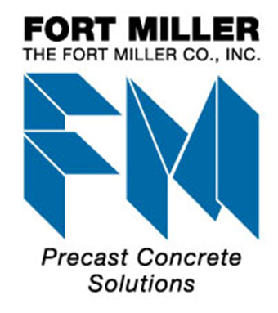
Precast Roads and Intersections
Alaska Concrete Alliance Meeting
May 3, 2016
Peter Smith, P.E.
The Fort Miller Co., Inc.
NPCA, PCI, Caltrans PCP Committees
SHRP2, ETG on Precast Pavement

Slide 2
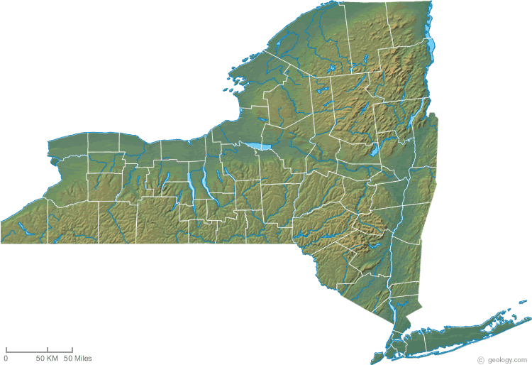
The Fort Miller Co., Inc.
Located in upstate New York
Transportation products
  Highway barrier
  Precast retaining walls
  Bridges
  Precast pavement slabs
Specializing in accelerated bridge (and other structures) construction
Developer and promulgator of the Super-Slab® Precast Pavement System
Schuylerville, NY

Slide 3
Why Precast Concrete Pavement?
Precast slabs can be installed in very short work windows
  Enables concrete pavement replacement in 5 - 8 hour night work windows
Small work foot print (compared to CIP)
Precast slabs are more durable
  Cast in controlled conditions
  Testing (of installed pavement) show promise of 40+ years of service
Precast pavement + Premium pavement overnight!

Slide 4
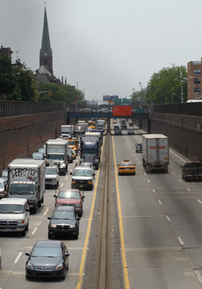
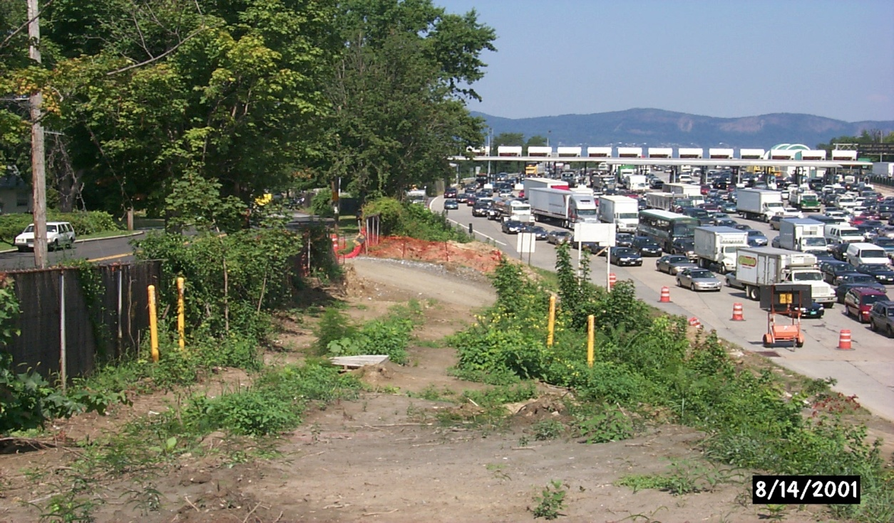
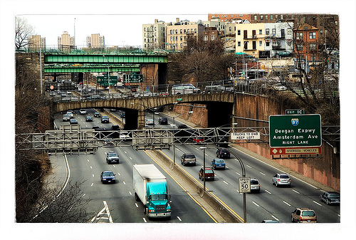
Precast Concrete Pavement Slabs = Overnight Repairs
145,000 ADT
I-287, Tarrytown, NY
180,000 ADT
Cross Bronx Exp.
162,000 ADT
Brooklyn-Queens Exp.
Notes:
4
Precast pavement slabs are particularly useful for rehabilitation of highly traveled concrete roadways because of the difficulty in re-routing traffic. Highways with such high traffic volumes frequently require work windows of eight hours or less and even then, only one or two lanes can be taken out of service.
Portions of all of the highways pictured above have been successfully repaired with precast pavement slabs.
The precast pavement repair technique may also be useful for highways of much lower ADT a certain locations such as approaches to bridges where shoulders for accommodating traffic detours are minimal or non-existant.

Slide 5
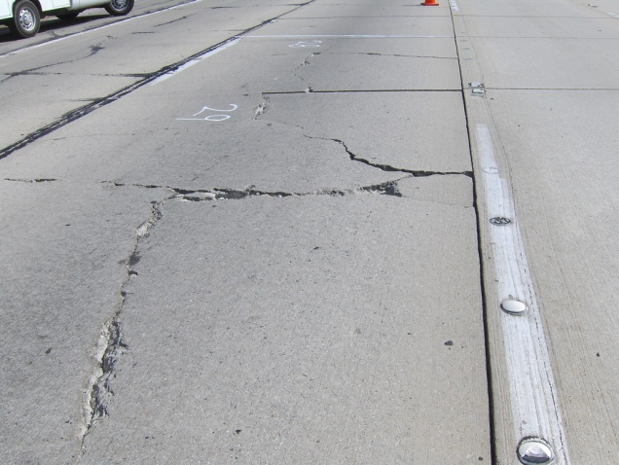
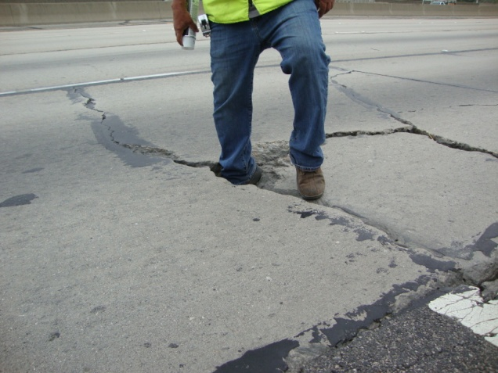
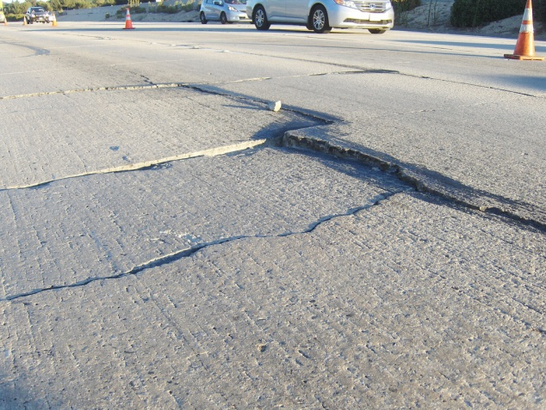
What’s Under your Interstate Traffic?
Shattered Slabs
Pasadena, CA
Failed Rapid Set Patches
Hollywood, CA
Heavily Faulted Slabs
Pasadena, CA
210 Freeway, Pasadena, CA
Notes:
5
Precast pavement slabs are particularly useful for rehabilitation of highly traveled concrete roadways because of the difficulty in re-routing traffic. Highways with such high traffic volumes frequently require work windows of eight hours or less and even then, only one or two lanes can be taken out of service.
Portions of all of the highways pictured above have been successfully repaired with precast pavement slabs.
The precast pavement repair technique may also be useful for highways of much lower ADT a certain locations such as approaches to bridges where shoulders for accommodating traffic detours are minimal or non-existant.

Slide 6
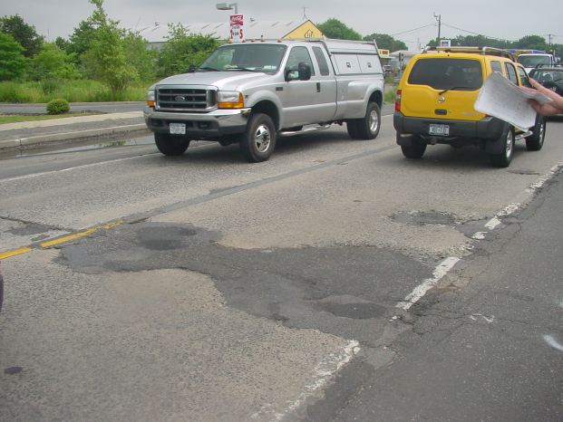
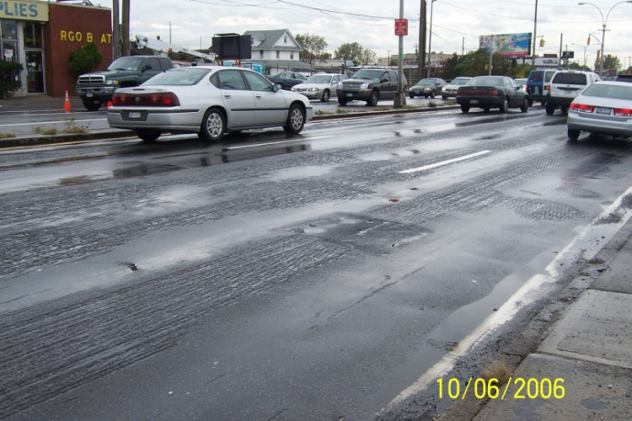
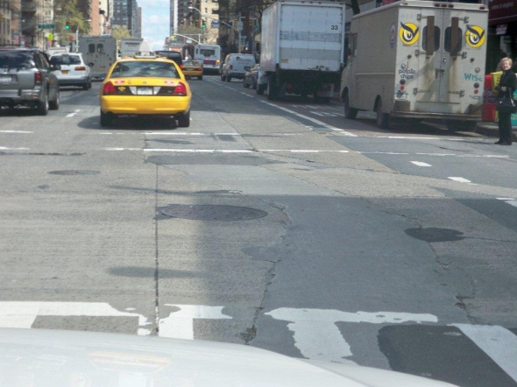
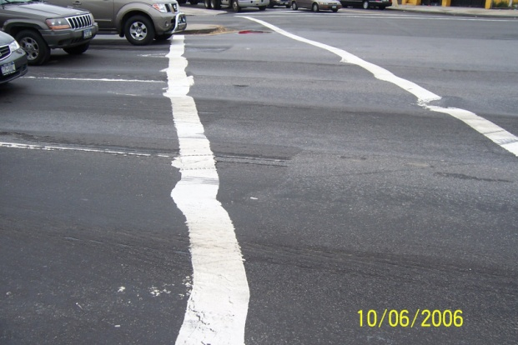
Urban Arterial & Intersection Pavement in Poor Condition
50 Year Old Pavement
Poor Surface Drainage
Many Utilities
Rutted Asphalt Overlays
Notes:
Super-Slab® is used for total replacement of existing ramps. Three such projects are shown above.

Slide 7
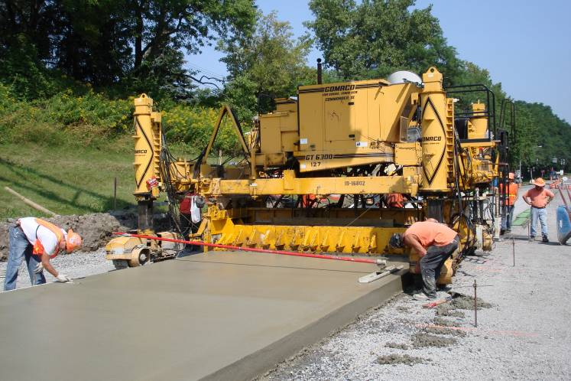
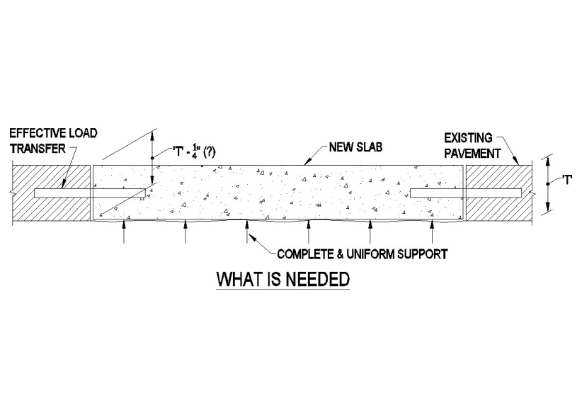
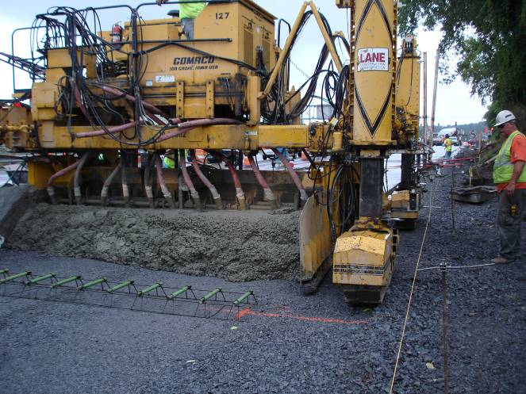
Precast Pavement Emulates Cast in Place
Full and complete support
Load transfer dowels
Grade control
Slab surface geometry

Slide 8
Overview of Current Load Transfer Systems
Precast Prestressed Concrete Pavement (PPCP)
  Pre & post tensioned ( 250’+ assembly)
Top-Slot systems
  Michigan (dowel bar retrofit) Method (wide top slot)
  Caltrans “Tear Drop” (narrow top slot)
Over-sized center hole system
  Sliding dowel systems
Bottom slot Super-Slab® system
  Jointed – slabs 6’ to16’
Other systems are “appearing”

Slide 9
Overview of Current Bedding/Grade- Control Systems
“Precisely-graded bedding material
  Super-Slab grade-supported system
  Illinois State Toll Highway grade-supported system
Leveling/Lifting inserts
  California grout-supported system
  Super-Slab grout-supported system
Urethane-supported systems
  Roman Road system ’

Slide 10
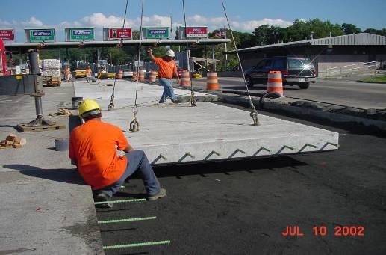
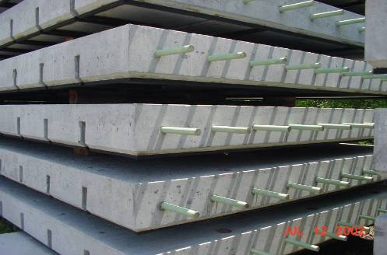
Grade-Supported, Bottom-Slot
Super-Slab® System
Simple slab-on-grade system
Standard dowels and tie bars (JRCP)
Built-in bedding grout distribution
Precision grading equipment
Warped and planar surfaces
25,000 + slabs = 2,800,000 SF INSTALLED
Fort Miller provides design and field support
(100 projects, 44 lane-miles completed in 17 States + ONT & QUE)
Notes:
10
These photos give a bird’s eye view of what the slabs look like, stockpiled in our yard and what they look like as they are set in place on the project. The embedded dowels, tie bars and matching inverted dovetail slots are seen in both photos.

Slide 11
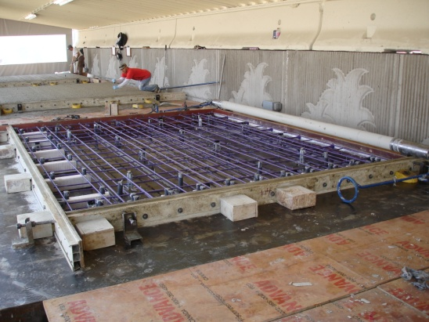
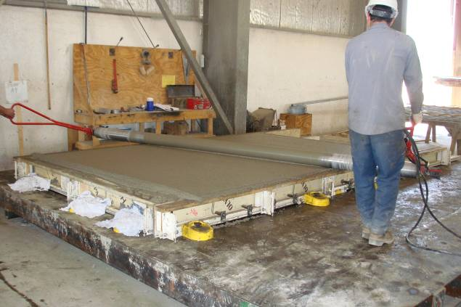
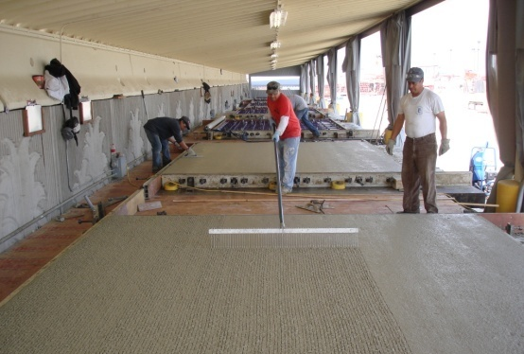
Controlled Fabrication Conditions
The Fort Miller Co., Inc.
Accurate Forms
Roller Screed - Accurate Top Surface
Accurate Piece Drawings
Ideal Finishing (and curing) Conditions
Notes:
The big advantage of precast pavement slabs is that they are fabricated in controlled conditions optimizing concrete strength and quality.

Slide 12
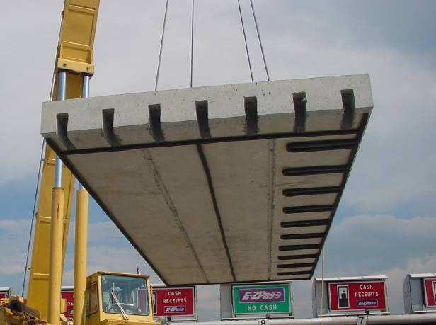
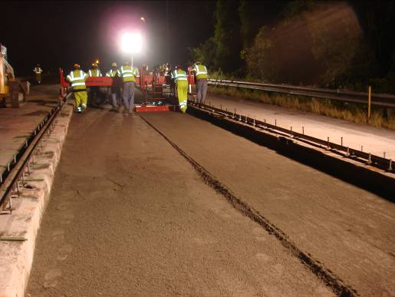
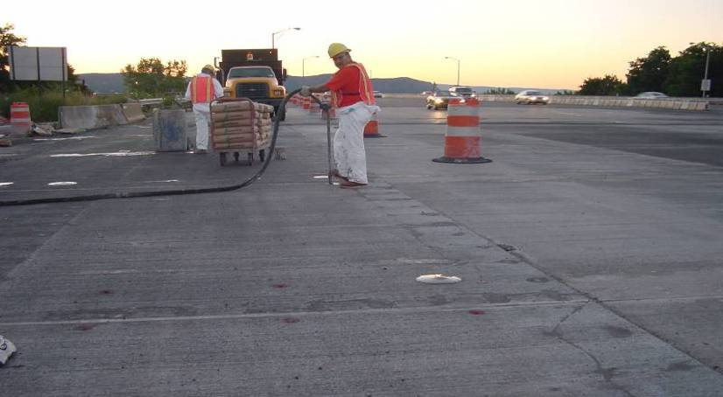
Achieving Full and Complete Bedding
A Two - Step Process
Secondary Bedding
Primary Bedding
*Grout Distribution
Channel
Grade control rails placed to survey marks
Foam Gaskets
Chorded Slab Surface
Precisely-Graded (to + 1/8”) and Compacted Fine Aggregate Material
Proof
Bedding Grout Fills Any Voids
Notes:
The Super-Slab® System accomplishes full and complete bedding in two steps. In the first step, bedding material is accurately graded to a tolerance of + 1/8th inch to provide nearly complete support and grade control to the slab. The second step, taken after the slab has been placed, is to pump a very fluid bedding grout through grout ports cast into the slab at each end of half-round grout distribution channels cast on the bottom of the slab. The channels are visible in the photo above. Foam gaskets attached to the bottom of the slab insure the bedding grout is retained to fill any voids that may exist under the slabs.

Slide 13
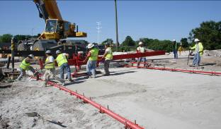
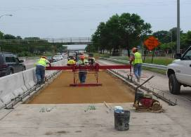
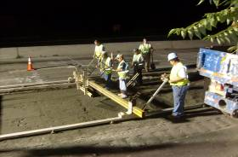
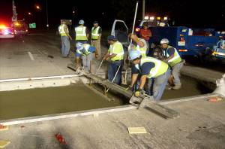
Small Scale Grading Rail Supported and Hand Operated – Accurate to 1/8” +/-
Auger H.O.G.
Hand Operated Grader (H.O.G.)
Mini-H.O.G.
Shutter Screed
Notes:
13
The Fort Miller Company has developed four models of grading equipment to address various types of specific grading situations. The Auger HOG can span up to 26’ and is used for continuous full lane-width replacement projects. The HOG can span up to 16’ and is suitable for continuous and intermittent grading projects. The Mini-HOG has a crossbeam that is supported on rollers at each end for use on projects with varying lane widths. The Shutter Screed is a lightweight precision screed suited for intermittent replacement projects.
Fort Miller has developed and improved the family of HOG graders to the point that for large scale, full lane width continuous paving projects, the productivity of the Auger-HOG can equal or exceed that of the Somero equipment.
All four members of the HOG family run on rails in order to provide grade control to the degree of accuracy required for complete support of the precast slabs.

Slide 14

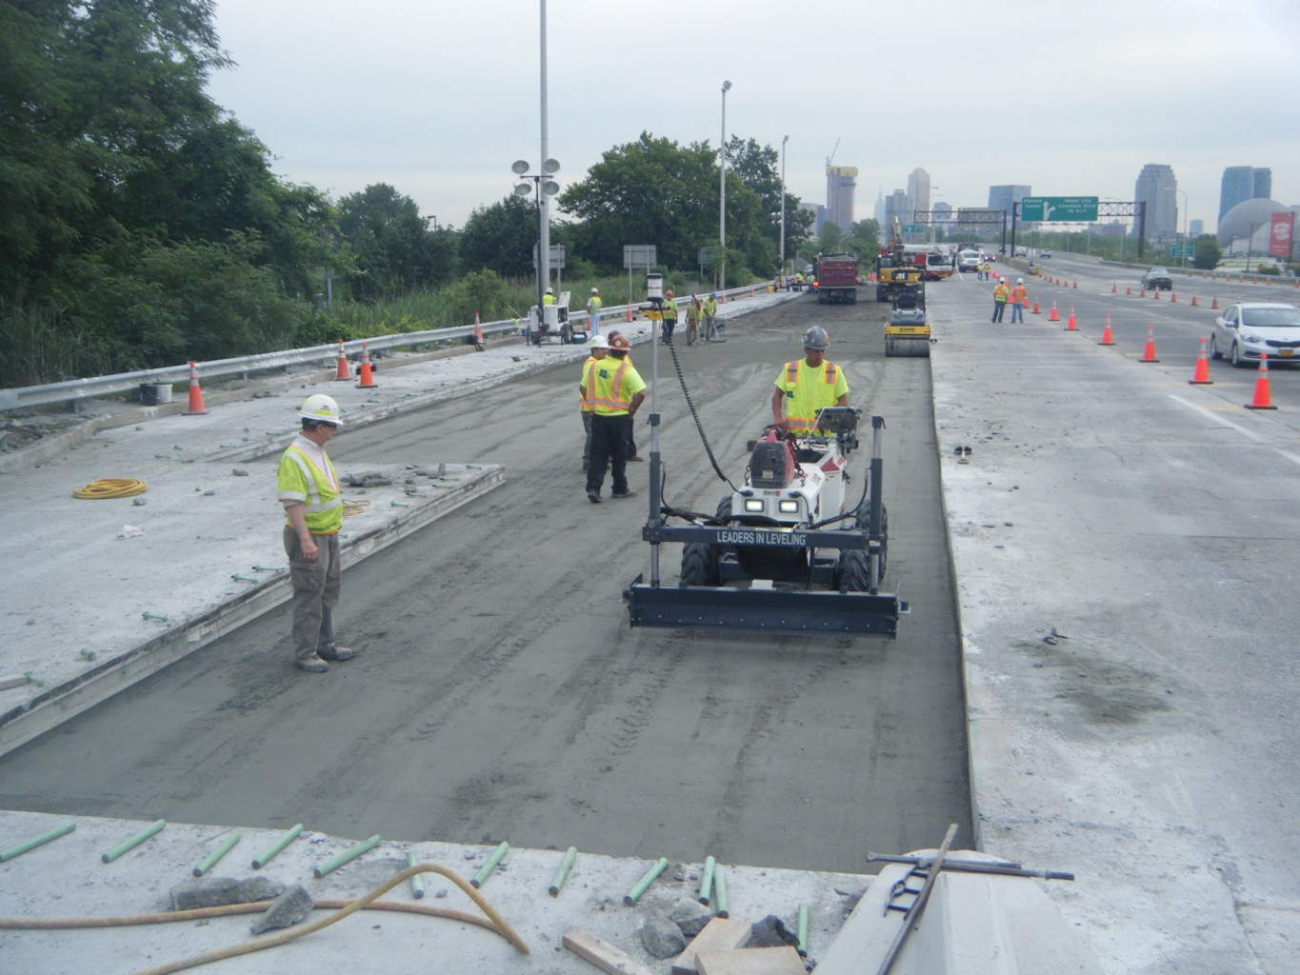
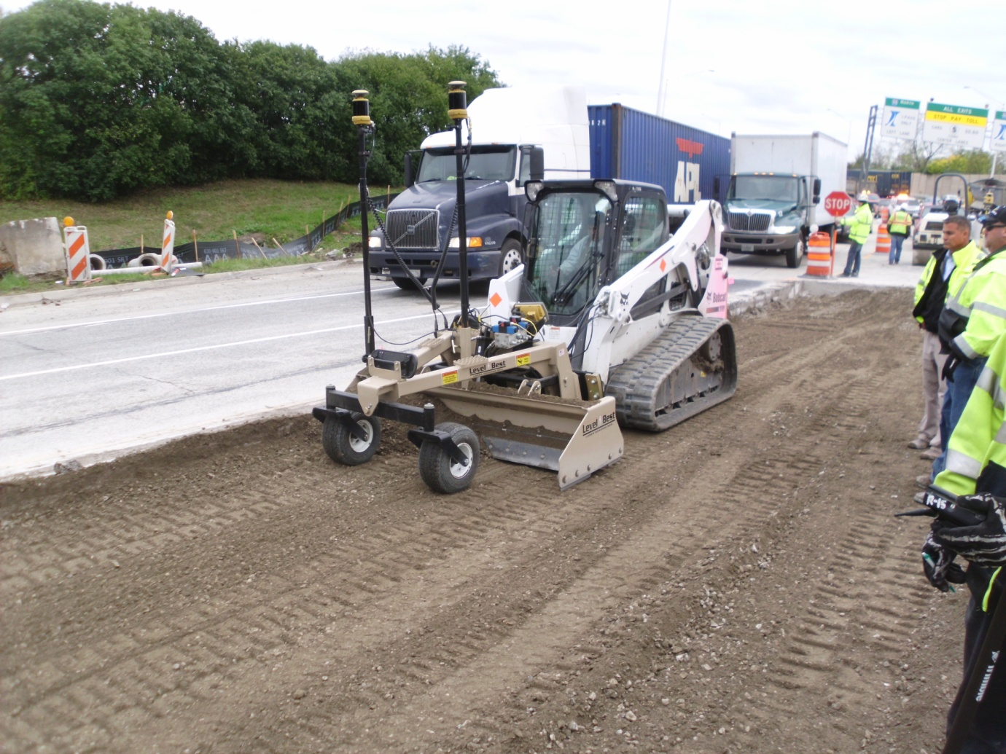
Large-Scale Grading Equipment Accurate to 1/8” +/-
Laser-Controlled Somero Concrete Finisher
Lase-Controlled Skid-Steer-Mounted Grader
Utilize digital surface model for grade reference

Slide 15
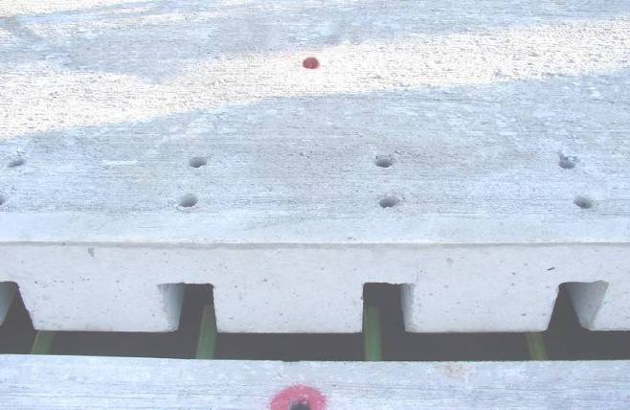
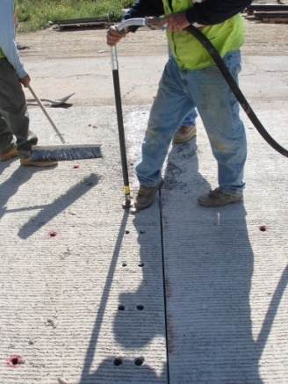
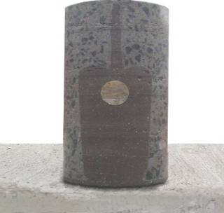
Super-Slab®
Load Transfer Dowel System
Dowels engage slots in adjacent slab
Pump dowel grout into ports
  Grout reaches 2500 psi
  in about 2 hours
Fill slots and joint between slabs
Dove-tail slot resists bar pop out
Dove-tail-shaped slot
Notes:
The inverted dovetail slots are advantageous because they place dowel grout on the bottom of the slabs, away from de-icing salts and provide a mechanical interlock that is far superior to slots that rely only on grout bonded to the vertical faces of the slots.

Slide 16
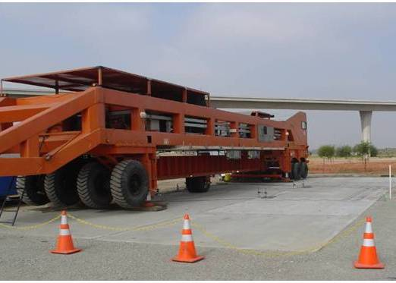
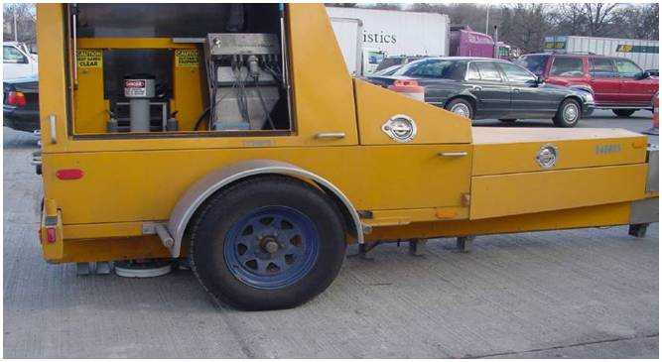
Indicators for Long Life -
Full-Scale Fatigue Testing in California
The Fort Miller Co., Inc.
Test results
show
no cracks or
distress
Heavy vehicle simulator
143 Million ESALs (100 KN Load)
4.3 Million Cycles
Falling Weight Deflectometer
Notes:
16
Numerous (on several projects) FWD test have shown average to excellent load transfer efficiency across transverse joints. In many instances, this is a system preapproval.
The HVS test performed in California in 2005 – 2006 indicates these slabs will withstand heavy loads over a long period of time. The test were concluded after 143 million ESALS was applied to the slabs, with no indication of cracks or distress.

Slide 17
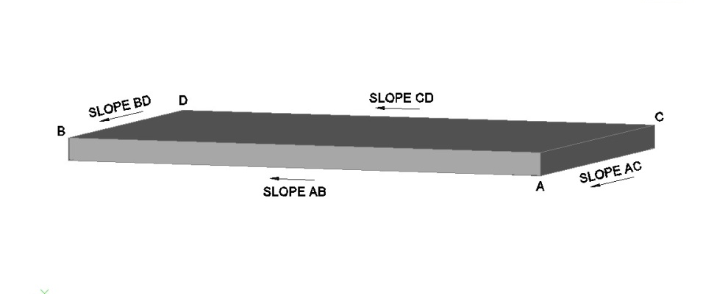
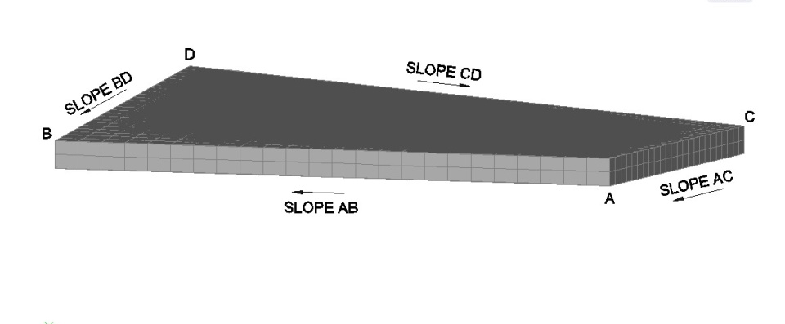
Surface Types
Single Plane
Warped Plane
Slopes of opposite sides are equal
Slopes of opposite sides are not equal
Notes:
17
There are two types of Super-Slabs. Single Plane slabs are flat planes in which the cross slope is constant from one end to the other.
Warped Plane Slabs have three corners of the slab in the same plane while the 4th corner is either higher or lower than the plane of the other 3. In warped slabs the cross slope varies uniformly from one end of the slab to the other.
The subgrade surface, which is the grade control for the slabs, must be built exactly parallel to the three-dimensional roadway surface because all of the slabs are of a constant thickness.
The building of three-dimensional slabs and a matching subgrade surface are important keys to the Super-Slab® technology and to the success of the System.

Slide 18
Types of Projects
Intermittent repair (patching) – most common
Area placement
  Toll plaza & mainline
Ramps
Intersections
Bus pads
City streets
Miscellaneous
Notes:
The inverted dovetail slots are advantageous because they place dowel grout on the bottom of the slabs, away from de-icing salts and provide a mechanical interlock that is far superior to slots that rely only on grout bonded to the vertical faces of the slots.

Slide 19
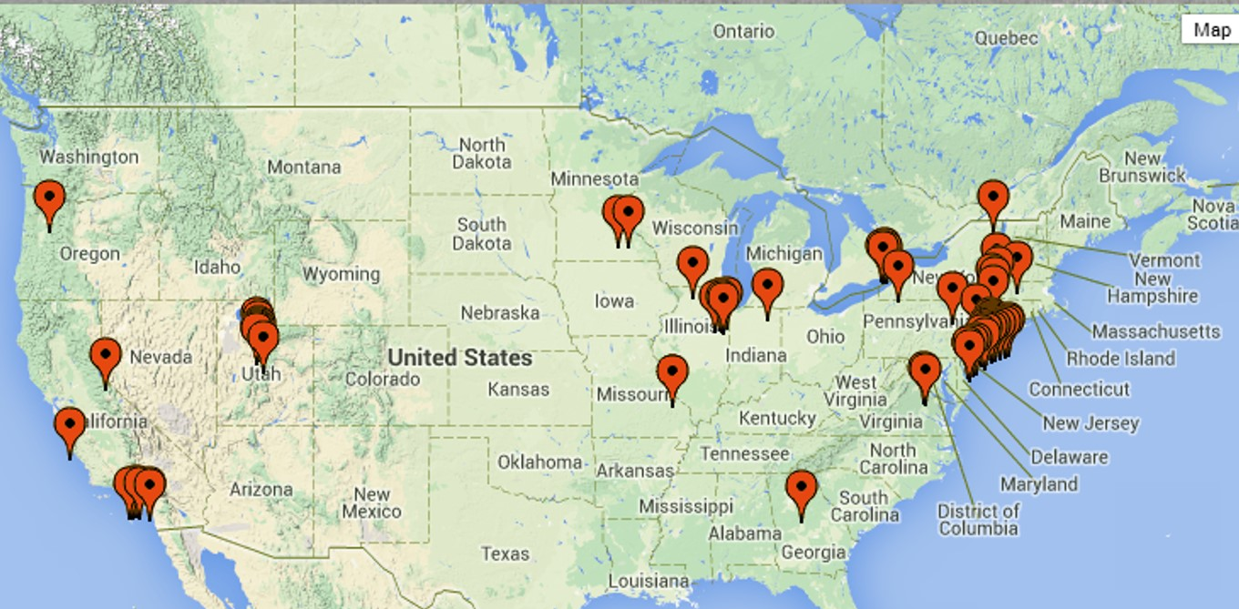
80+ Lane Miles – Where are they?
http://precast.org/precast-product/paving-slabs/ (NPCA Web Site)

Slide 20
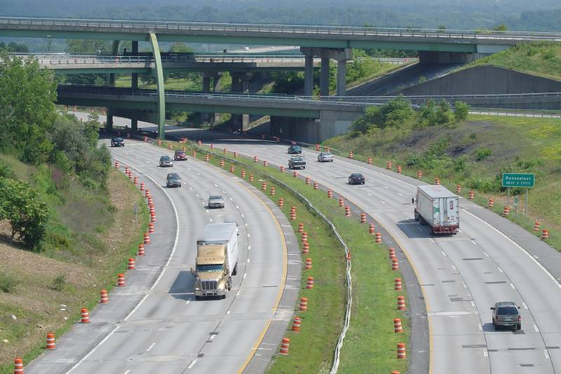
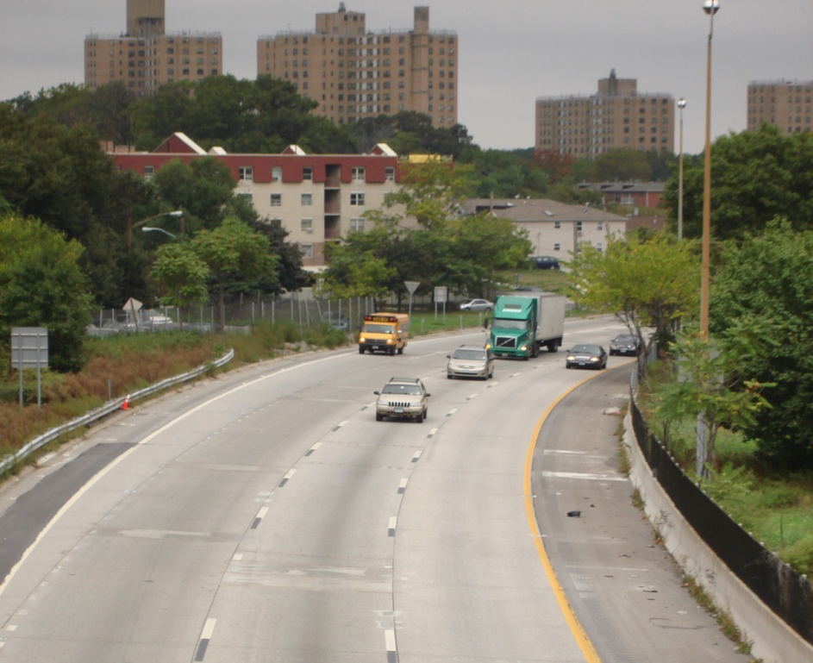
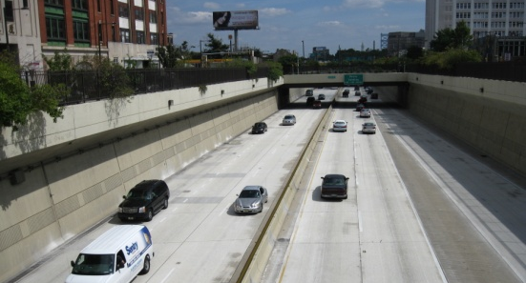
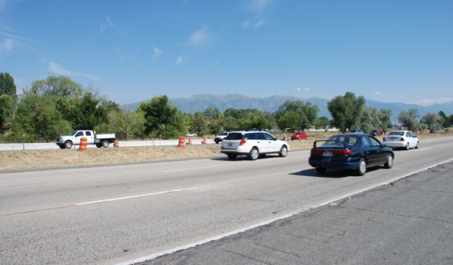
The Fort Miller Co., Inc.
Intermittent Repairs (CPR)
I- 90
Albany, NY
Eight Hour Work Windows
I-676 Vine St Expressway
Philadelphia, PA
Eight Hour Work Windows
Five Hour Work Windows
Eight Hour Work Windows
I-95, New Rochelle, NY
(two projects – same road – seven years apart)
I-15 Salt Lake City, Utah
Notes:
20
Super-Slab is used to make full depth repairs intermittently as shown in the photos above. A menu of slab sizes is established at the beginning of the project. Repair areas are identified, marked and assigned a slab size. When the slabs are installed, a hole is cut in the existing pavement to match the slab size.
For overnight repair, the old pavement is sawed during previous night periods. During removal night the old slab is lifted out, dowels are installed in the existing pavement, the subgrade is prepared and the slabs are placed in preparation for immediate use by the traveling public.
Since the slabs are nearly fully supported by the accurate subgrade surface, un-grouted slabs are frequently opened to traffic shortly after installation. The grouting is completed in subsequent nights.
Once the learning curve was over the contractor on this project installed, on average, 15 slabs per each 8 hour night shift.

Slide 21
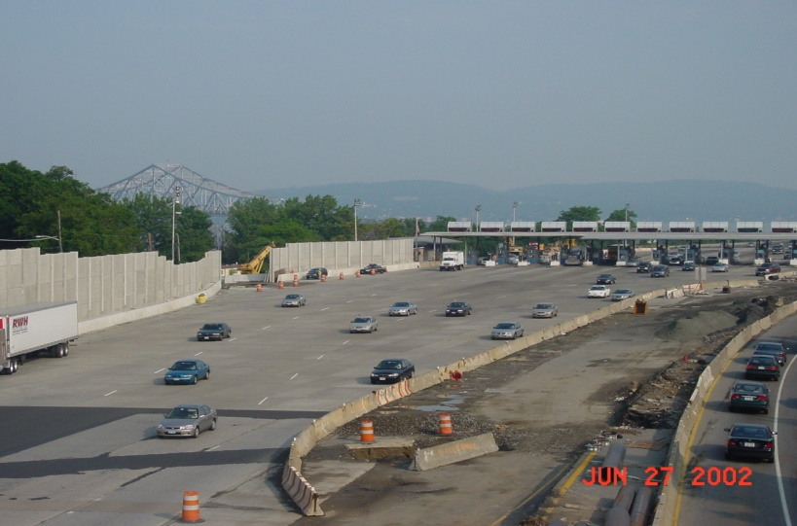

The Fort Miller Co., Inc.
Continuous -
Tappan Zee Bridge Toll Plaza
Off Peak Hours =
20 Hour Work Windows
3,000 SF / 8 Hour Shift
(Within + 1/8”)
Open for Rush Hour
(135,000 ADT)
2001 - 2002
Notes:
In 2001 and 2002 the entire pavement (160,000 SF) of the Tappan Zee Bridge Toll Plaza in Tarrytown, NY, seen in the upper left photo, was replaced while maintaining the traffic shown (at the daily morning rush hour) in the photo in the lower right. On average, 3000 SF of pavement was replaced each shift. Slabs were actually set at the rate of 8 to 10 slabs per hour.

Slide 22
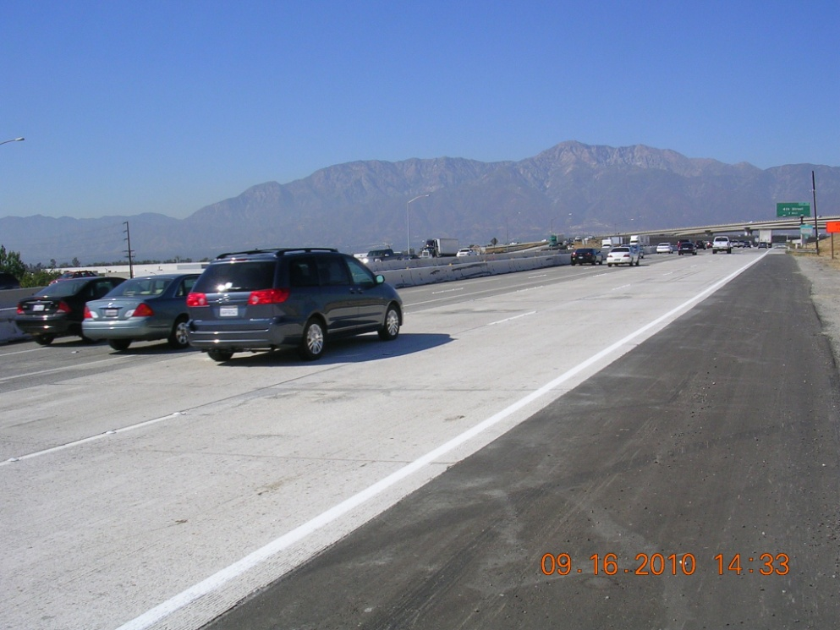
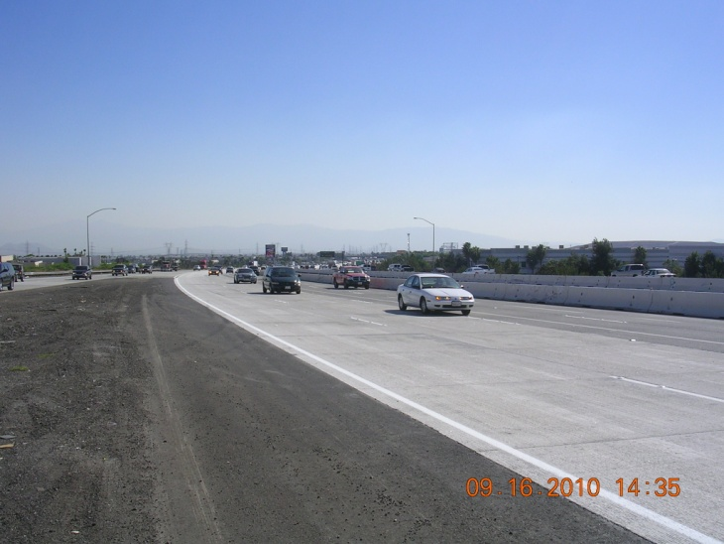
Continuous - Mainline Placement
8 Hour Night Work Windows
Mainline I-15, Ontario, CA
(500 Lane Feet - 200,000 VPD)
Notes:
The I-15 / I-10 junction in Ontario, CA carries 216,000 VPD including heavy truck traffic. Single-lane and double-lane sections of existing five-lane I-15 NB on a 1.5-mile project were replaced on a demonstration project partially funded by FHWA’s Highways for LIFE program. 500 lane-feet on average were placed each night in an 8-hour work window.

Slide 23
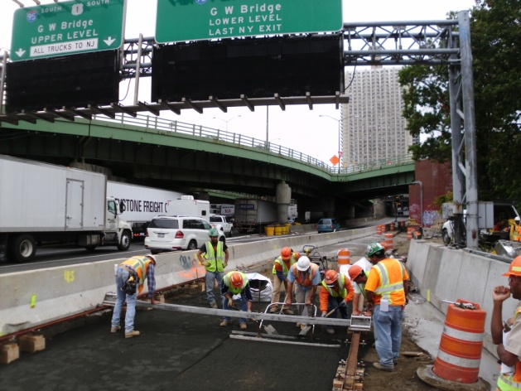
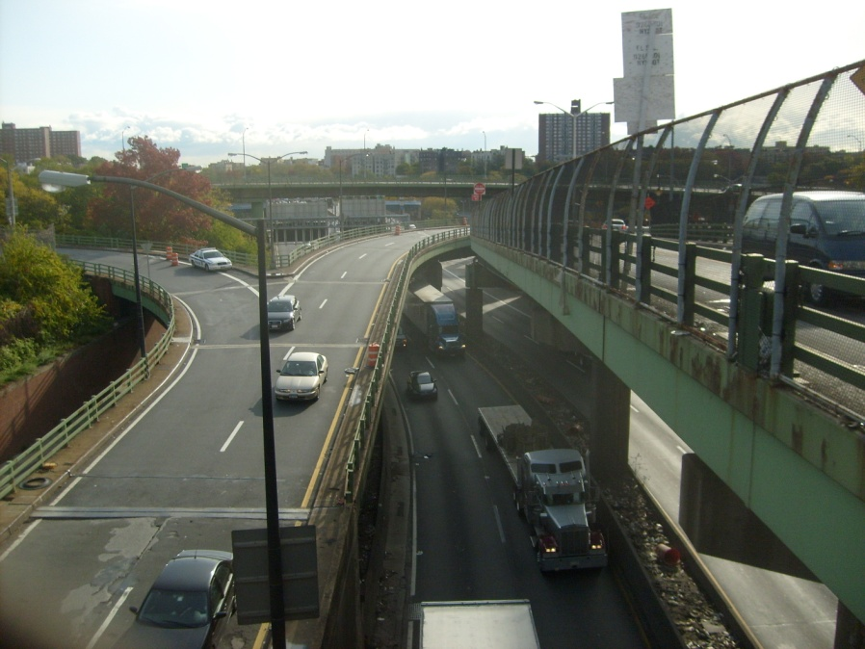
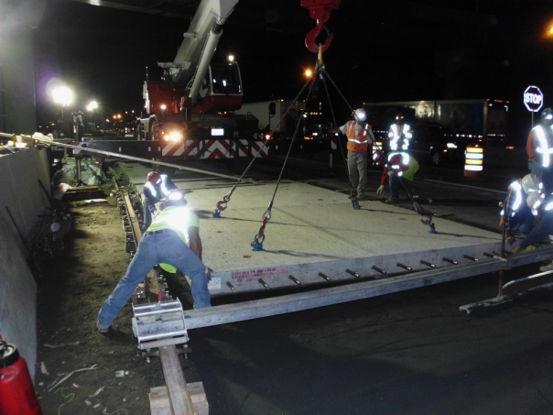
Alexander Hamilton Bridge
W. Approach - Continuous, 2011 – 2013
Grading
Five Hour Work Windows
Lower Level
Contractor Gets One Lane
To Replace The Same Lane
Notes:
In 2006 the first major intersection was completed in Rotterdam, NY. The entire intersection was replaced in 18 night shifts. The entire intersection was opened to traffic without restriction each morning. A very large intersection project is currently underway near Kennedy Airport in Brooklyn where intersection over about six miles of Rockaway Boulevard is being replaced during eight hour night work windows.

Slide 24
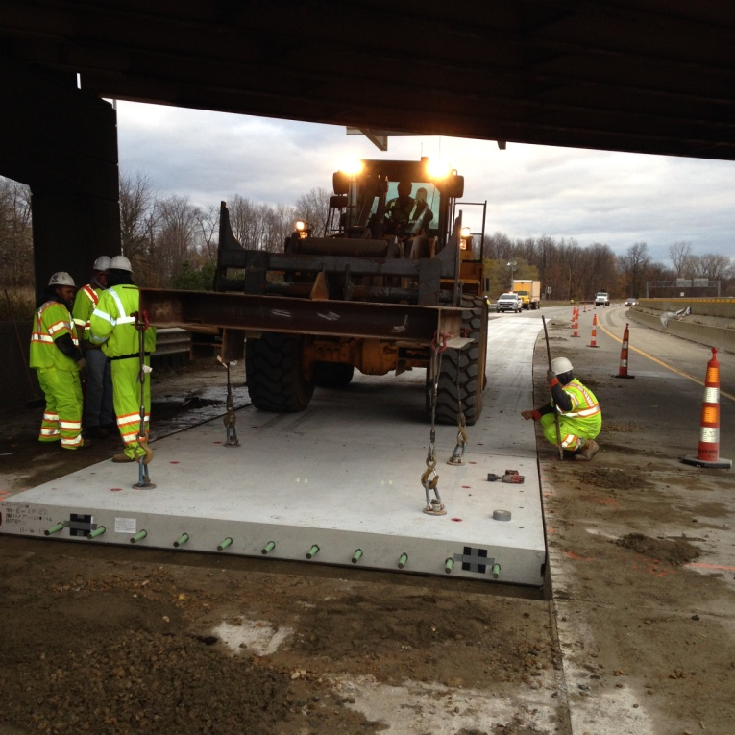
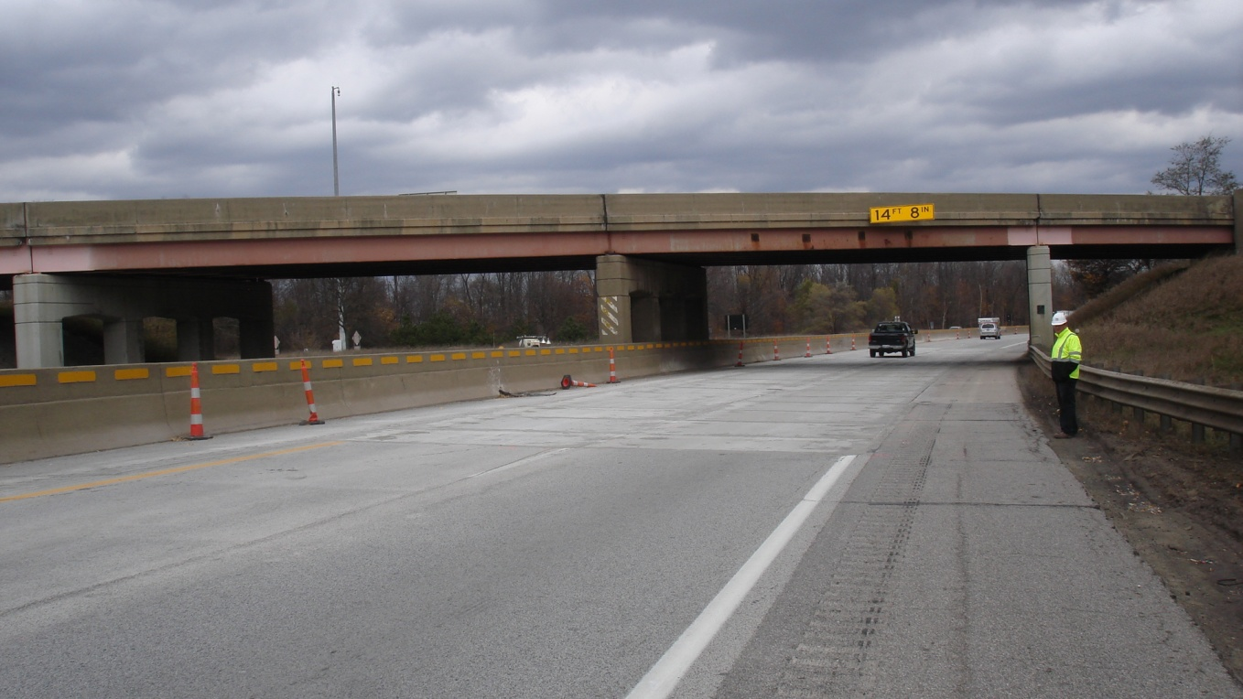
Continuous Under Low-Clearance Bridges, I-94, Kalamazoo, MI
New Panels (before Grinding)
Installation
Two Lanes Completed
Notes:
This information is based upon bid prices for the Super-Slab® System. While available cost data is limited there does appear to be a slight trend for installed costs to be coming down in states where precast slabs are more widely used.

Slide 25
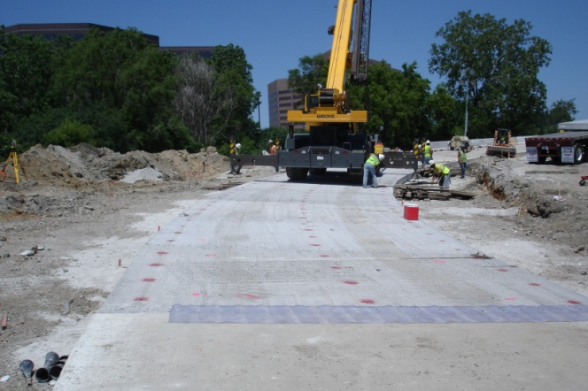



Ramps
Oak Brook, IL
Plan View, Tarrytown, NY
Eight Hour Work Windows !
Belt Parkway, Queens, NY
Street View, Tarrytown, NY
Notes:
Super-Slab® is used for total replacement of existing ramps. Three such projects are shown above.

Slide 26


Intersections – Replacing Composite Pavement, – Rotterdam, NY - 2006
New & Old
Slab Layout Drawing
Only critical part precast (new CIP around it)
198 slabs placed in 17 Nights
Built under live traffic conditions
Undercuting
Notes:
In 2006 the first major intersection was completed in Rotterdam, NY. The entire intersection was replaced in 18 night shifts. The entire intersection was opened to traffic without restriction each morning. A very large intersection project is currently underway near Kennedy Airport in Brooklyn where intersection over about six miles of Rockaway Boulevard is being replaced during eight hour night work windows.

Slide 27


NY 7 Crosstown Connection
Ten Hour Work Windows !
Street View
(Complex Grades)
Aerial View
( Complex Horizontal Geometry)

Slide 28


Intersections & Bridge Approach Slabs US 73, Leavenworth, KS 2015
4th Street & Rt. 73 Intersection
294 Slabs
Over 60% Warped (up to 1.75”)
Approach Slabs Rt. 73 over Missouri River Bridge

Slide 29


Intersection Approaches – Replacing Full Depth Asphalt With Precast
Farmers Blvd. Rockaway Blvd., Queens, NY
Guy R. Brewer Blvd., Rockaway Blvd., Queens, NY
Intersection approaches and entire roadway - 1/2 mile

Slide 30

Entire Intersection – Turning Lane
2390 slabs
29,000 SY
Replaced full-depth asphalt
300 lane-ft per 8-hour shift
Brookville Blvd. - Rockaway Blvd., Queens, NY

Slide 31



Bridge Approach Slabs – NYS DOT
(Existing Bridges)
Cross Section at Abutment
One Lane per Stage
(2009)
Binghamton, NY (2009)
Notes:
Super-Slab may be used for total pavement replacement or for repair patches.

Slide 32


New Bridge and Approach Slabs
Total Replacement
US 46 Over Broad St., Clifton, NJ
Bridge replaced over two weekends - April 2011
Two-span (40.2’, 40.2’) continuous, 28.76° skew
Precast Approach Slabs - tied to prefabricated bridge units
Bridge Units
Rt. 46 over Broad St., Hackensack, NJ, 2011
Skewed Approach Slabs

Slide 33




Brooklyn Bridge 1,000’ Approaches
2010 – 2014
Eight Hour Work Windows
Grading
Night Placement
Weekend Placement
Finished Oct. 2014
Notes:
In 2006 the first major intersection was completed in Rotterdam, NY. The entire intersection was replaced in 18 night shifts. The entire intersection was opened to traffic without restriction each morning. A very large intersection project is currently underway near Kennedy Airport in Brooklyn where intersection over about six miles of Rockaway Boulevard is being replaced during eight hour night work windows.

Slide 34




Bus Pad, Hollywood & Santa Monica Blvd.
North Hollywood, CA
Grading
Placing
Eight Hour Work Windows !
Last Slab
Finished, Next Day
Notes:
Super-Slab® is used for total replacement of existing ramps. Three such projects are shown above.

Slide 35


City Streets - GDOT Broad Street ,Winder, GA
FHWA HFL – 348 Slabs
5% Grades, Horizontal Curves, Intersections,
Widenings, Cross Slope Transitions
Notes:
35
This presents a brief overview of Super-Slab installations now completed in the U.S. and Canada.

Slide 36


Instrumented Precast Pavement, Spring Valley, NY
Instrumented High Speed EZ Pass Slabs
Imbedded Treadles
Overnight installation – plug and play installation
Notes:
This information is based upon bid prices for the Super-Slab® System. While available cost data is limited there does appear to be a slight trend for installed costs to be coming down in states where precast slabs are more widely used.

Slide 37


Weigh-In-Motion Panels – I-95 Manhattan, NY
341,000 ADT
Fabrication Stainless Steel Reinforcing and Dowels
374,000 ADT
Installation (Overnight)
Plug and Play (Overnight)
Notes:
37
Precast pavement slabs are particularly useful for rehabilitation of highly traveled concrete roadways because of the difficulty in re-routing traffic. Highways with such high traffic volumes frequently require work windows of eight hours or less and even then, only one or two lanes can be taken out of service.
Portions of all of the highways pictured above have been successfully repaired with precast pavement slabs.
The precast pavement repair technique may also be useful for highways of much lower ADT a certain locations such as approaches to bridges where shoulders for accommodating traffic detours are minimal or non-existant.

Slide 38



Industrial Driveways
City of Mamaroneck, NY
Continuous Access During Construction
Notes:
Super-Slab® is used for total replacement of existing ramps. Three such projects are shown above.

Slide 39
New Frontiers
Removable/Re-usable Urban Pavement (RUP)
  For utility-intensive streets and urban arterials
Smart patching
  Adding new slabs to previously-placed ones
  Incremental total replacement
Un-bonded inlays (overlays)
  To harden up asphalt pavement
Precast roundabouts
Notes:
Super-Slab® is used for total replacement of existing ramps. Three such projects are shown above.

Slide 40





New Products – Removable Dowels and Tie Bars
Patent Number 8,840,336
Half Dowel With Extraction Bolt
Removable-Replaceable Tie Bars
Super-Dowels

Slide 41
Removable Super-Dowels and Tie Bars Enables:
  Removable/Replaceable Urban Pavement (RUP)
    For utility-intensive arterials and city streets
  Smart Patching
    Incremental addition to precast pavement

Slide 42



New Method – Use RUP – Cut Dowels and Remove Panels As Needed
Remove As Needed
Super-Pavers Installed Over Utilities
Clean Up Removed Panels

Slide 43



Restore Remaining Half Dowels and Tie Bars and Replace Cleaned-Up Panel
Extracting Half Dowel
Replacing Cleaned-Up Panels
Restores Esthetics and Functionality of Original Pavement
Restoring Tie Bars

Slide 44

Smart Patching
Super-Dowels
Super-Dowels
Add patches only as needed
Save precast patches for 40 years?
Makes The Most of Original Concrete Pavement
Restore roadway only as needed
Notes:
Super-Slab® is used for total replacement of existing ramps. Three such projects are shown above.

Slide 45

I-95 Replacement Plan for 2015
Precast Placed in 2015
Super-Dowels
Placed in 2015
Precast Placed in 2007
Notes:
This information is based upon bid prices for the Super-Slab® System. While available cost data is limited there does appear to be a slight trend for installed costs to be coming down in states where precast slabs are more widely used.

Slide 46


Present vs. New Method of Addition
Present Method
  New Method
Saving per Eight Dowel Joint - $ 788.96 (New Method)

Slide 47
I-95 Savings (in 2021) Using Smart Method
OPERATION | “Q” | UNIT | COST/SAVINGS | TOTAL COST/SAVINGS
ESTIMATED POTENTIAL COST OF DOWELS IN 2015 (3125 JOINTS) | 25,000 | EA | $ 10.30 (UP-CHARGE PER DOWEL) | $ 257,500 (C)
ASSUME 13.8% OF 3125 JOINTS = 462 JOINTS in seven years (2021) | 431 | EA | $ 788.96 (SAVINGS PER JOINT) | $ 340,042 (S) (= 1,333 lane feet new pavement)
ASSUME 25% OF 3125 JOINTS = 462 JOINTS in seven years (2021) | 781 | EA | $ 788.96 (SAVINGS PER JOINT) | $ 616,178 (S) (= 2,415 lane feet new pavement)
100% OF JOINTS OVER TIME = 3125 JOINTS (OVER TIME) | 3125 | EA | $ 788.96 (SAVINGS PER JOINT) | $ 2,465,500 (S) (= 9,664 lane feet new pavement)
PROPOSED THRUWAY EXTRA EXPENDITURE IN 2015 = $ 257,500
TOTAL POTENTIAL SAVINGS = $ 2,465,500 = 9,664 Lane Ft.

Slide 48


Precast Inlays (Over Lays) in Asphalt
341,000 ADT Highway 427
374,000 ADT Highway 401
Hardening-Up Asphalt Pavement In Toronto – Pilot Project 2016
Notes:
48
Precast pavement slabs are particularly useful for rehabilitation of highly traveled concrete roadways because of the difficulty in re-routing traffic. Highways with such high traffic volumes frequently require work windows of eight hours or less and even then, only one or two lanes can be taken out of service.
Portions of all of the highways pictured above have been successfully repaired with precast pavement slabs.
The precast pavement repair technique may also be useful for highways of much lower ADT a certain locations such as approaches to bridges where shoulders for accommodating traffic detours are minimal or non-existant.

Slide 49

Overnight Inlay Details
Typical Cross Section
(For Rut Remediation and “Hardening-up” Asphalt Pavement) )

Slide 50
Precast Roundabouts
If we can draw it, we can make it.
Notes:
This is typically how many of our smaller roundabouts have been constructed and jointed. The joints radiating from the center of the roundabout.

Slide 51


Intermittent - Installation Rates
8 hour work window
  12 – 15 slabs (12’ x 10’) per night
5 hour work windows
  7 – 9 slabs (12’ x 10’) per night
Dependent on work window length
and spacing of repairs
Eight Hour Work Windows
Five Hour Work Windows

Slide 52


Continuous - Installation Rates
  8 hour night work windows
    10 – 30 slabs
    Ontario, CA 30 slabs per night = 500 lane feet
  Weekend closures
    8 – 10 (12’ x 14’) slabs per hour
    Chicago - 90 slabs per weekend (2013)
  Rates should improve
    Contractors more familiar
    Improved specialized equipment
Notes:
. .

Slide 53

Smoothness
Small differences are expected
  Fabrication tolerance
  Grading tolerance
Super-Slab® finished surfaces + 1/8”
  May be acceptable for slow speed traffic
Grind for best International Roughness Index
  Diamond Grinding is an accepted and cost-effective practice

Slide 54
Installed Costs (Bid Prices)
.
Intermittent Repairs
  About $ 244 to $ 500 per SY
  Similar to rapid-set concrete costs (in some states)
Continuous Installations
  About $ 244 to $ 401 per SY
  Up to 20% less than intermittent repair slabs
Varies greatly with
  Length of work window
  Size of project
  Local labor rates
Notes:
This information is based upon bid prices for the Super-Slab® System. While available cost data is limited there does appear to be a slight trend for installed costs to be coming down in states where precast slabs are more widely used.

Slide 55
Pavement - Asset Management Strategies With Precast Available
Use quality precast material every time
  40-year service life
Use maintenance dollars for good repairs, not temporary ones
Consider life cycle rather than first costs
Rather than patching, consider “Incremental total replacement”
  Keep adding on to good precast repair slabs
Consider “re-usable” precast pavement in utility-intensive areas

Slide 56
Benefits of Precast Pavement
Reduce construction-related traffic congestion
Longer lasting pavement repairs – Asset Preservation
  40+ years
  Reduced (long-term) repair costs
  “Get in, get out and stay out”
  “Total Incremental Replacement” – now possible
Reduces field inspection time and cost
  Precast slabs – plant inspected
Pre-engineered, pre-inspected slabs result in a superior finished pavement
Notes:
56

Slide 57
How can Alaska DOT do a Precast Pavement Project in Alaska?
Identify and qualify a project
  We can help with feasibility concerns
Develop a specification
  We can assist with that (we’ve had lots of practice)
Fabrication – by local precaster
  We can provide specialized form work and precaster training
Installation – by local contractor
  We can provide specialized grading equipment
  We can provide training and on-site assistance
DOT inspection
  We can provide training and on-site assistance

Slide 58



Specialized Forming Equipment
Grout Port and Channel Formers
Warping Bed and Side Rails
)
Bottom Slot Formers
)
Notes:
The form table is first leveled using conventional surveying instruments to +/- 1 mm accuracy. For warped slabs, the shop drawings indicate the δ (delta), the amount the D corner is displaced up or down from the plane established by the other three corners of the slab.
Beam “A” supports the formwork under the A-B side; Beam “B” supports the formwork under the C-D side.
The δ of the D corner is achieved by adjusting the screw jacks under Beam B by the correct amount. Take note that both ends of Beam B will need to be adjusted to get the D corner in the proper location, and to keep the C corner level with the A and B corners.

Slide 59
Keys to Success
The Fort Miller Co., Inc.
Good engineering
Open minds
Real partnering
Notes:
59

Slide 60

www.super-slab.com

Slide 61


Thank You
The Fort Miller Co., Inc.
0 – 518-695-5000 www.fortmiller.com
Peter Smith
V. P. Market Development
C - (518) 461-6421
psmith@fmgroup.com
Mike Quaid
Product Manager
C - (518) 817-9485
mquaid@fmgroup.com
Dan Moellman
Senior Product Engineer
C - (518) 461-4759
dmoellman@fmgroup.com
Notes:
61

Slide 62
Questions?

