Slide 1


Superhydrophobic Engineered Cementitious Composites (SECC)
Scott Muzenski
Ismael Flores-Vivian
Konstantin Sobolev
2014 Alaska Concrete Summit
November 25, 2014

Slide 2
Outline
Superhydrophobicity
Surface Hydrophobization
Internal Hydrophobization
Flexible SECC
Field Study
Future Work / Conclusions

Slide 3
Problem
In most applications, concrete surface is exposed to liquids, such as water, mineral solutions, oil, solvents, etc.
A liquid such as water, is absorbed by the capillary forces.
The capillary forces are determined by: (M. Stefanidou et al., 2013)
  the surface tension of the liquid,
  the contact angle between the liquid and the pore walls, and
  the radius of the pores
The durability (i.e. freeze-thaw and sulfate attack) of concrete depends on its overall absorption and permeability to aqueous solutions. The cumulative effect of freeze-thaw cycles eventually cause expansion, cracking, scaling and crumbling of the concrete.
Maria Stefanidou, Katia Matziaris and Georgios Karagiannis, Hydrophobization by Means of Nanotechnology on Greek Sandstones Used as Building Facades, Geosciences 2013, 3, 30-45; doi:10.3390/geosciences3010030

Slide 4
Needs
The creation of an Superhydrophobic Engineered Cementitious Composite (SECC) can provide a much extended lifespan for critical elements of bridges and other transportation infrastructure.
Moreover, the use of SECC materials in highway infrastructure can significantly reduce the need for maintenance.

Slide 5
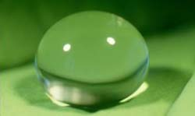
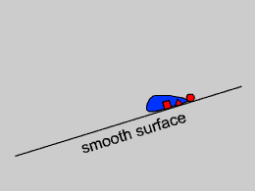
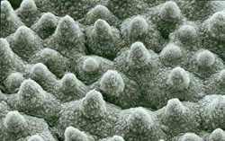
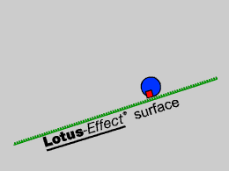
SELF-CLEANING SUPER-HYDROPHOBIC SURFACES

Slide 6
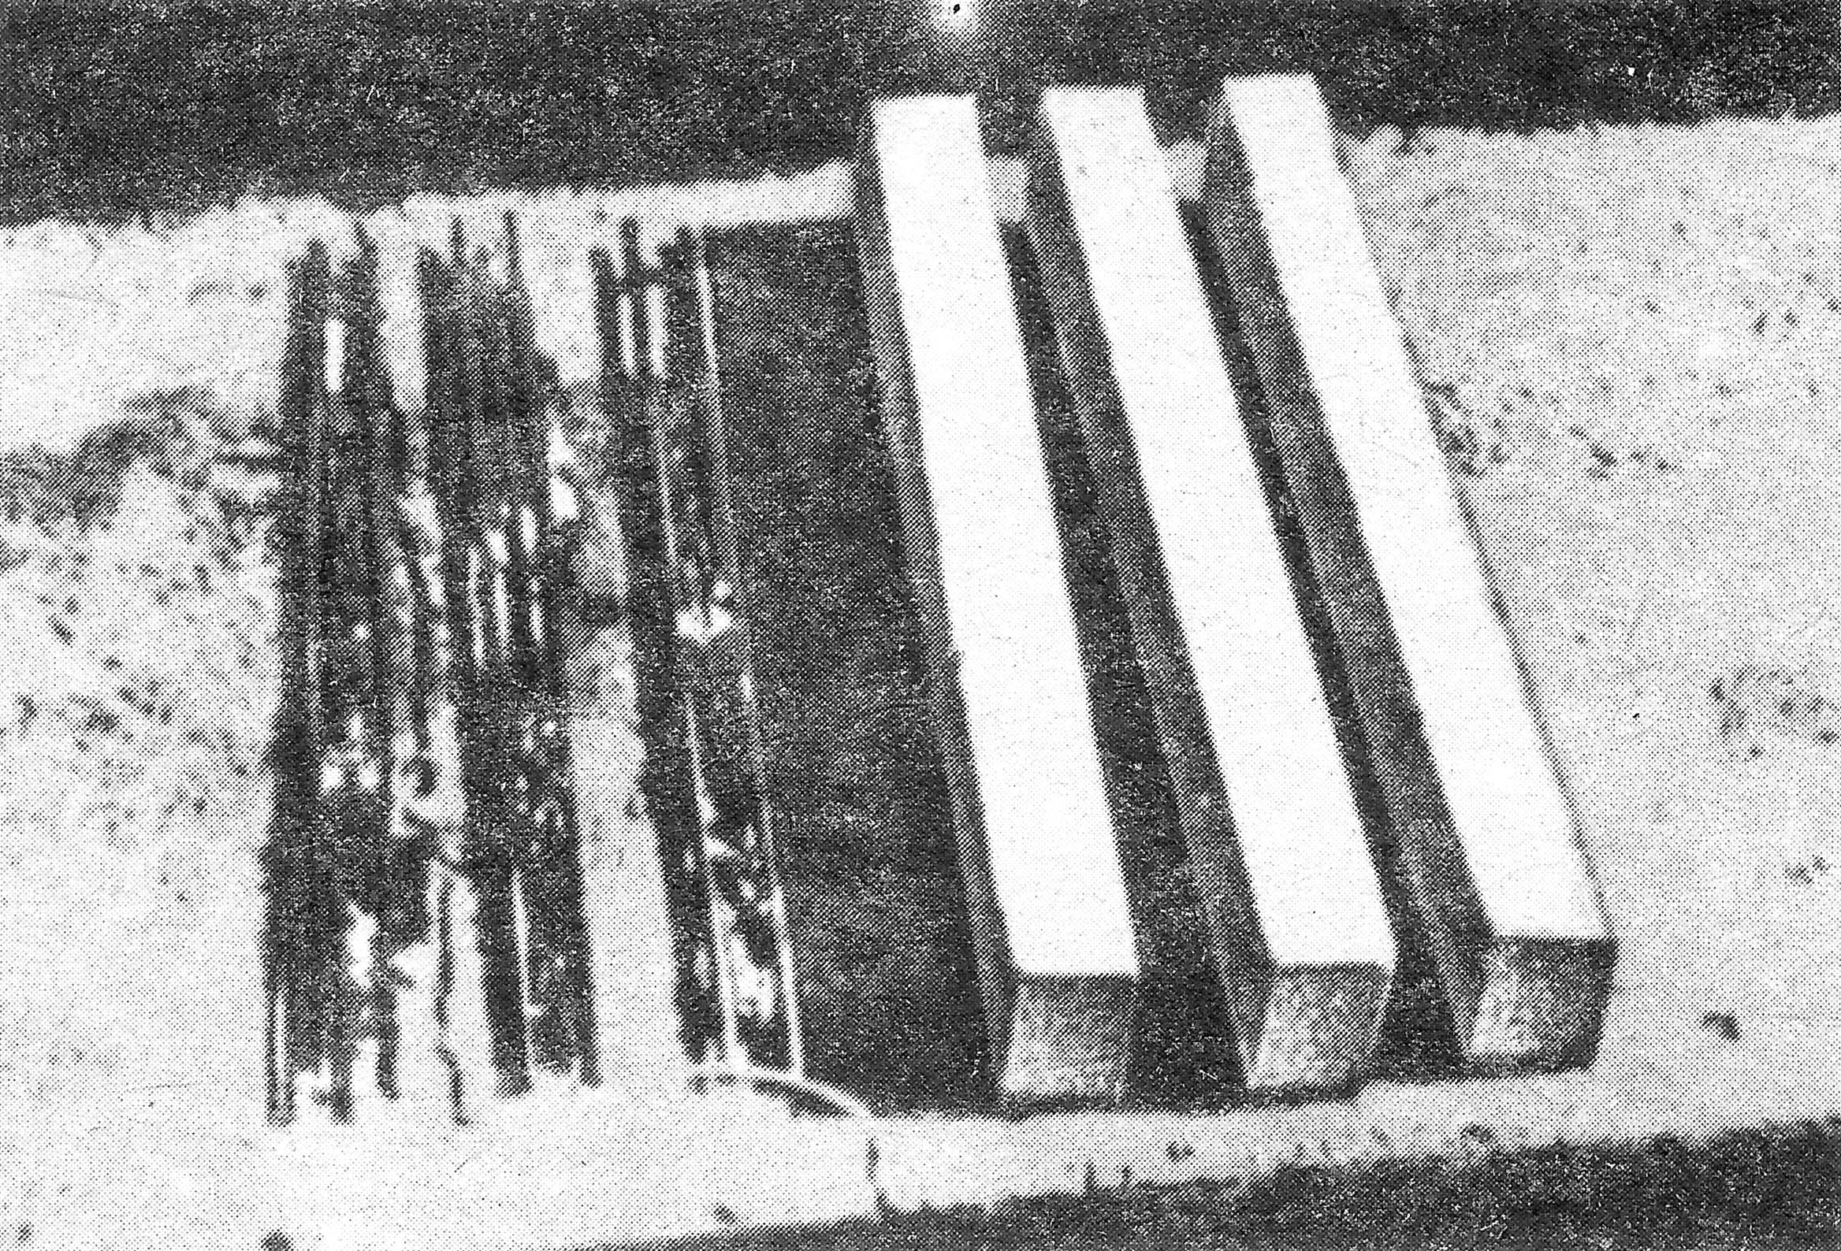
LITERATURE REVIEW
Literature: SCI Finder:
1410 references containing "hydrophobic coating"
237 references containing "superhydrophobic coating "
14 references containing "hydrophobic concrete"
2 references containing "superhydrophobic concrete"
Patents USPTO:
87/1077 patents containing "hydrophobic coating"
3/8 patents containing "superhydrophobic coating“
  7,914,897 Superhydrophobic coating by Zimmermann et al
  7,419,615 Renewable superhydrophobic coating by Strauss
  6,994,045 Superhydrophobic coating by Paszkowski
2/31 patents containing "hydrophobic concrete"
No patents containing "superhydrophobic concrete“
Available literature, patents and products are related to superhydrophobic surface coatings on glass, metals, and glazed ceramics. Many of these coatings have poor long-term performance on concrete due to poor wear resistance: “the application of sealer at the time of construction, without any reapplication in later years, was not effective in reducing chloride ingress.”
120 cycles
Reference concrete
2000 cycles
15 years

Slide 7

Superhydrophobicity
Engages interdisciplinary work combining^{1,2}:
  biomimetics (lotus effect),
  chemistry (use of siloxane polymers), and
  nanotechnology (use of nano-SiO₂ particles)
1. Sobolev K. and Batrakov V., The Effect of a PEHSO on the Durability of Concrete with Supplementary Cementitious Materials. ASCE Journal of Materials in Civil Engineering, 19(10), 2007, 809-819.
2. Sobolev K. and Ferrada-Gutiérrez M., How Nanotechnology Can Change the Concrete World: Part 2. American Ceramic Society Bulletin, 11, 2005, 16-19.
Image. Michael, N. and B. Bhushan, Hierarchical roughness makes superhydrophobic states stable. Microelectronic Engineering, 2007. 84(3): p. 382-386.

Slide 8
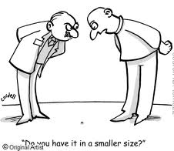
CONCRETE WITH
NANOPARTICLES
Why Nanoconcrete?

Slide 9
PARTICLE SIZE SCALE
RELATED TO CONCRETE ^{[1]}
[1] Sobolev K. and Ferrada-Gutiérrez M., How Nanotechnology Can Change the
Concrete World: Part 2. American Ceramic Society Bulletin, No. 11, 2005, pp. 16-19.

Slide 10
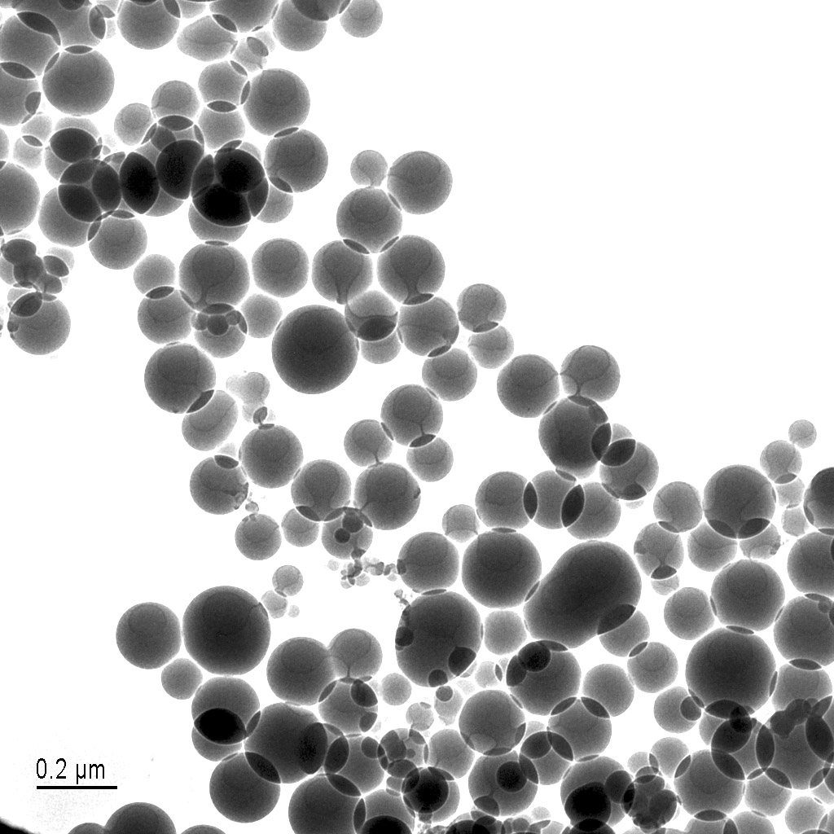
Silicon dioxide nanoparticles (or nanosilica) can be used as an additive for high-performance and self-compacting concrete improving workability and strength of concrete. courtesy of Dr. Andri Vital,
EMPA Materials Testing and Research
APPLICATION OF
NANOPARTICLES
Nanosilica under TEM

Slide 11
Surface Hydrophobization

Slide 12
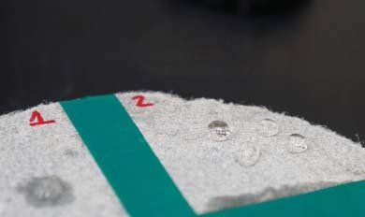
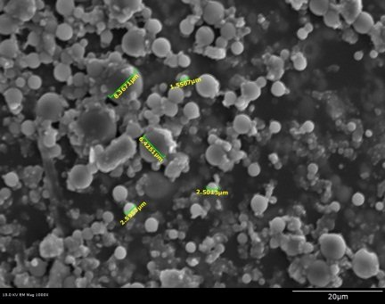
Surface Hydrophobization

Slide 13
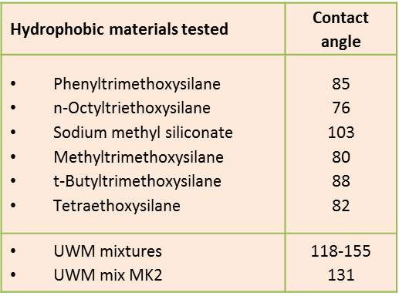
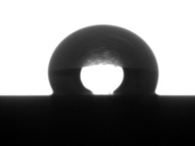
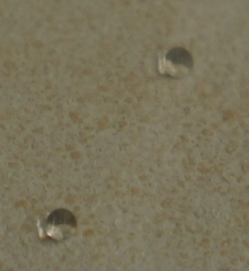
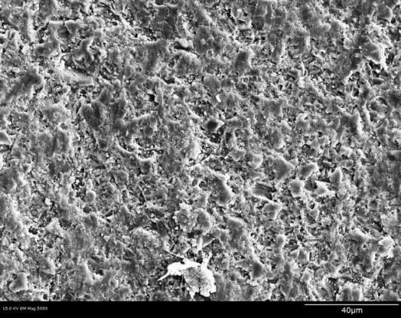
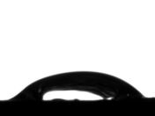
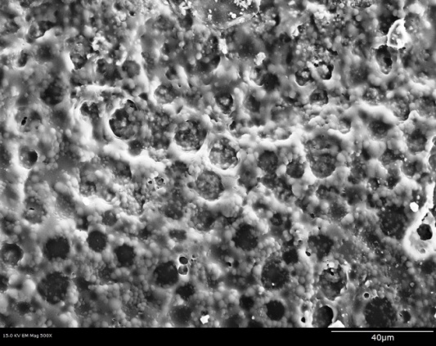

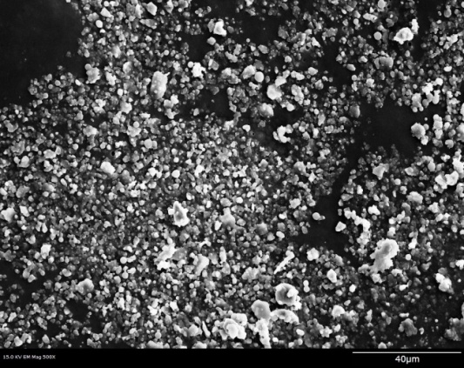
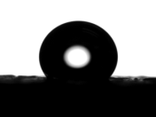
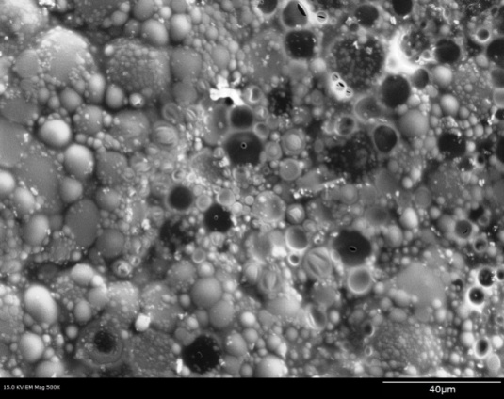

Surface Hydrophobization
θ = 103º
Na Me siliconate
on ceramic tile:
The contact angle of mortar specimens with single- and double- superhydrophobic coating:

Slide 14
Surface Hydrophobization
The contact and roll off angle of specimens with single (Mk)- and double (DMk)- coatings

Slide 15
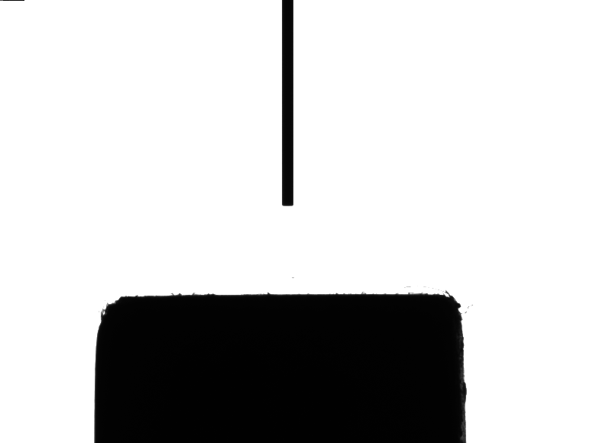

Slide 16
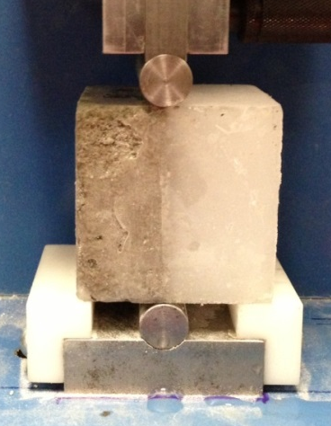
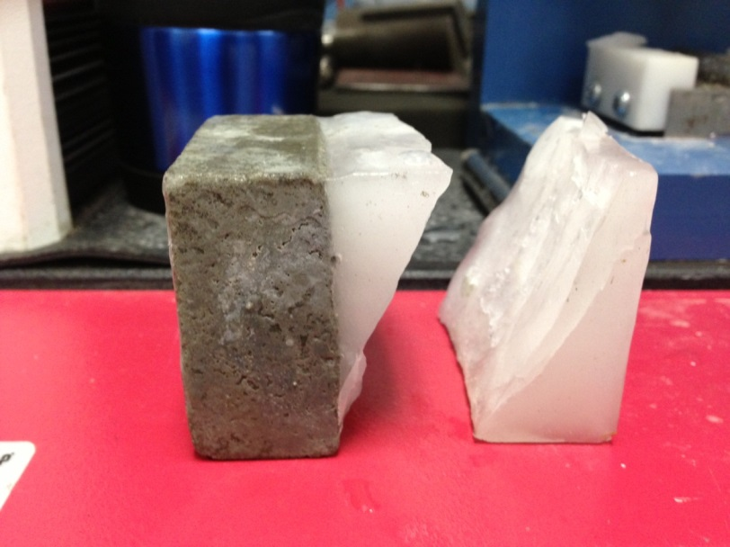
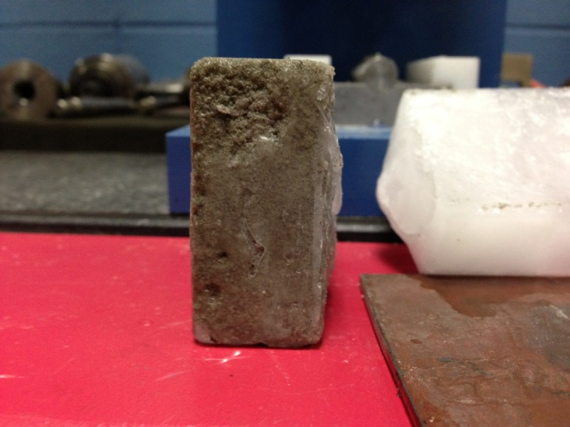
Ice-phobization Concrete

Slide 17
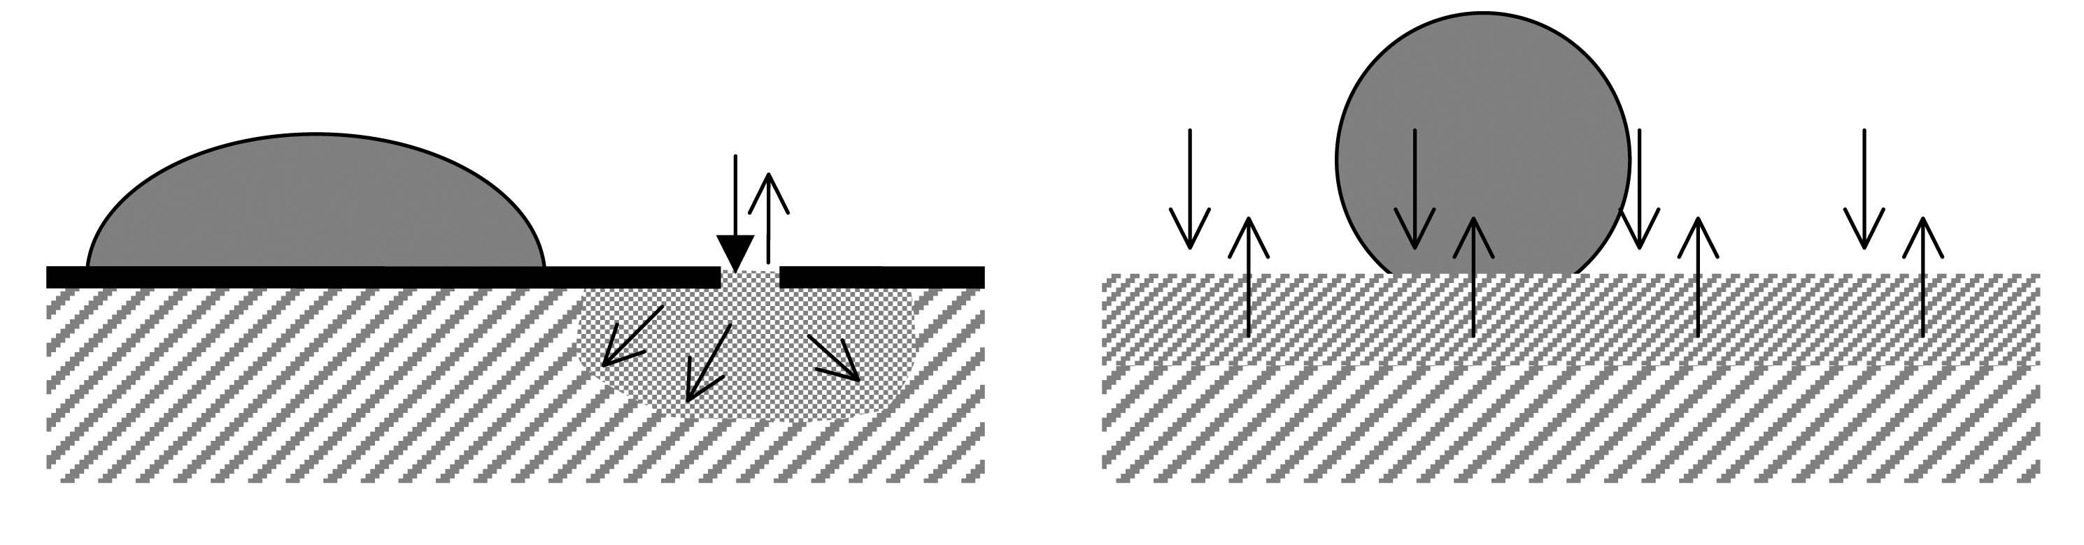
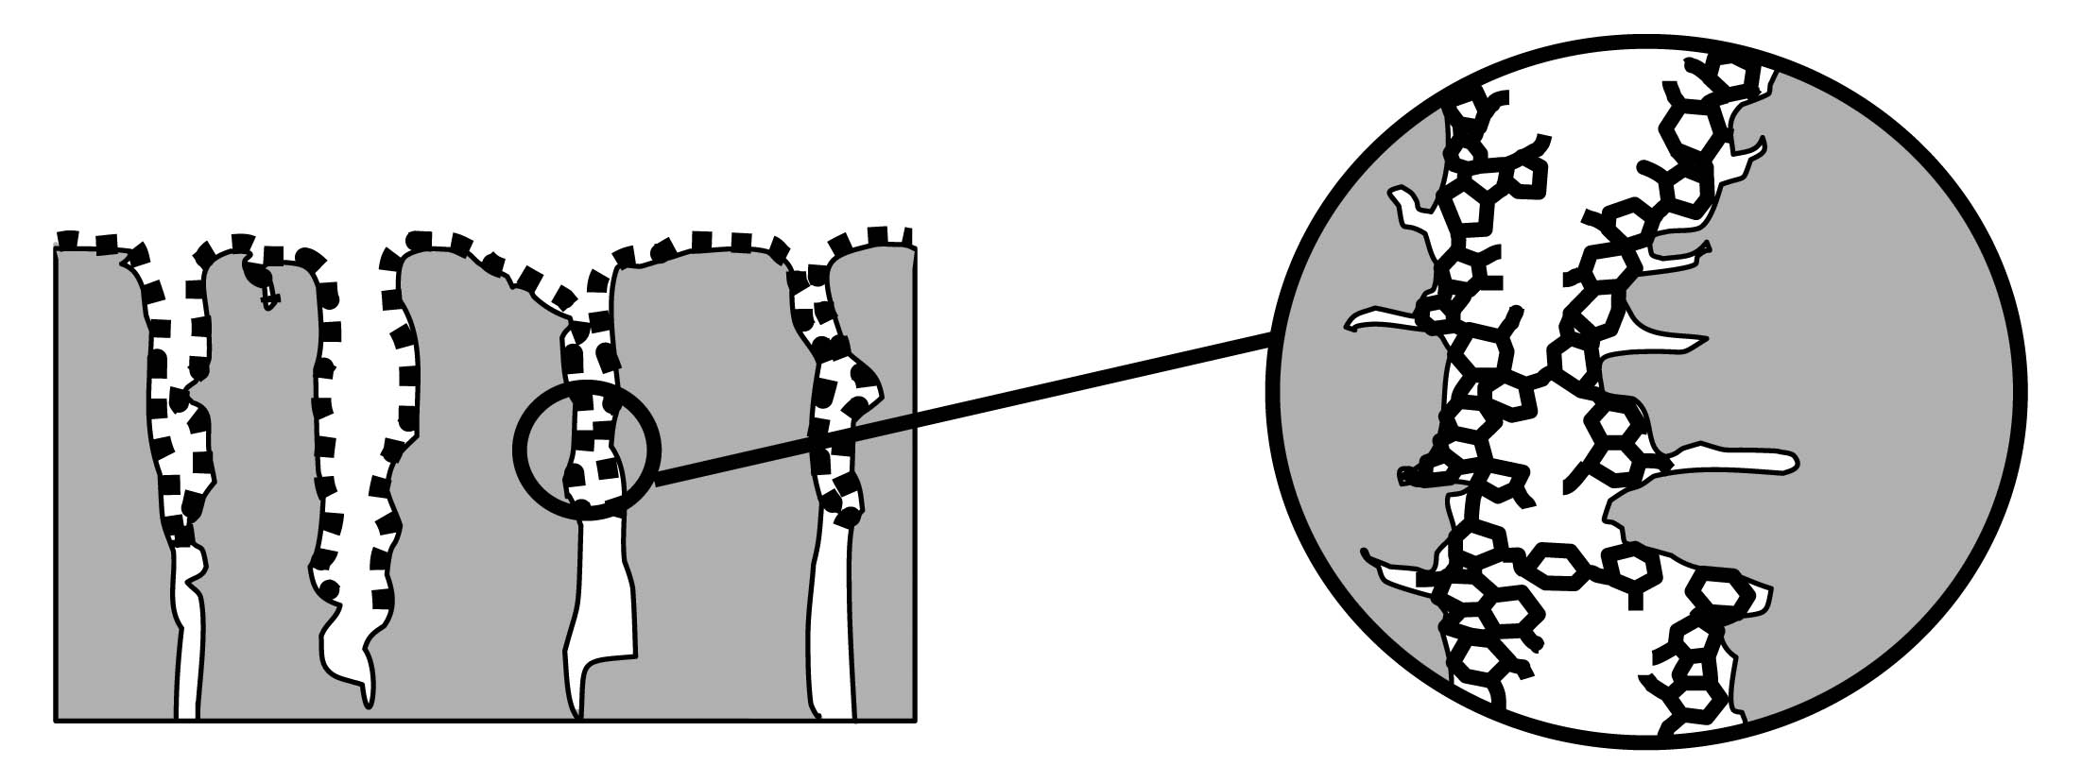
Hydrophobization
Sealing the surface;
Making the surface hydrophobic;
3- D (volume) hydrophobization.
Schematic representation of a polymer network →

Slide 18
Concept of Internal Superhydrophobic Admixtures

Slide 19
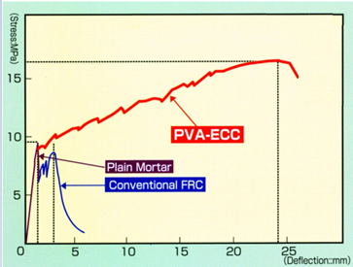
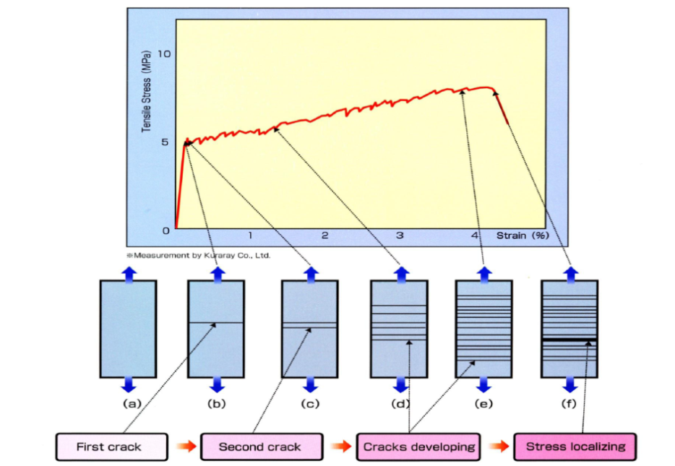
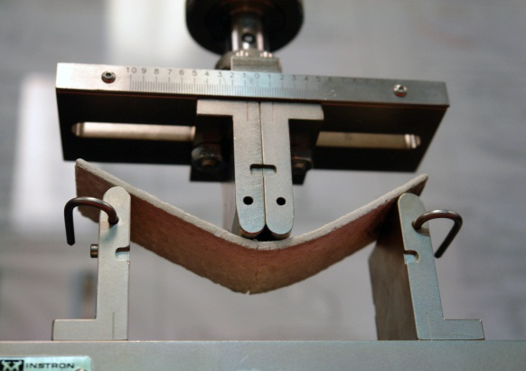
Strain Hardening and Engineered Cementitious Composites (ECC)

Slide 20
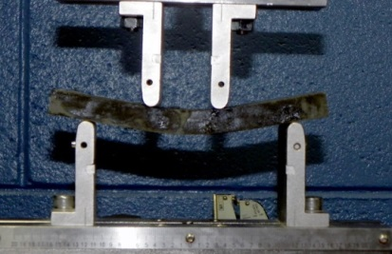
Combining Superhydrophobicity with ECC

Slide 21
Approach
The use of superhydrophobic fiber-reinforced composites:
  Use polyvinyl alcohol (PVA) fibers as a reinforcement to create an ultra-ductile cementitious material;
  Incorporate up to 50% of supplementary cementitious materials (SCM) as replacement for portland cement;
  Incorporate a superhydrophobic air void system to resist against freezing and thawing and improve ductility;
  Create a dense matrix to reduce permeability.
  Superhydrophobic material capable of withstanding large loads and deformations without failure creates a material with a significantly increased lifespan.

Slide 22
Approach
The use of superhydrophobic admixtures:
Creates a well distributed air void structure;
Creates small spherical voids;
Reduce permeability and absorption;
Introduces artificial flaws within the cementitious matrix to initiate cracking and strain-hardening behavior;
Can be combined with a strong matrix.
Superhydrophobic Admixture Composition:
  25% Siloxane
  4.4% Polyvinyl Alcohol as an emulsifier
  0.4% Metakaolin
  0.1% Nano Si0₂

Slide 23
Applications
ECC have the ability to flex or deform before fracturing and it is more resistant to cracking and last considerably longer than normal concrete
Proposed uses for SECC include bridge decks, concrete pipes, roads, structures subjected to seismic and non-seismic loads, expansion joint, repairs, infrastructure exposed to freezing and thawing cycles or marine enviroments and other applications where a strong and durable building material is desired.

Slide 24
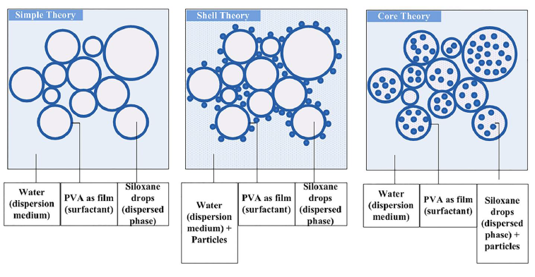
Testing of Admixtures
Mix ID | Admixture Type | Quantity of particles
1-REF | None | None
2-AEMA | Commercial AE | None
3-ECSF | Core | Silica Fume
4-ECMK | Core | Metakaolin
5-ECNS | Core | Nano-Silica
6-ECR | Simple | None
7-ESSF | Shell | Silica Fume
8-ESMK | Shell | Metakaolin
9-ESNS | Shell | Nano-Silica
10-ECNMK | Core | Nano-Silica and Metakaolin

Slide 25
Testing of Admixtures

Slide 26
Testing of Admixtures

Slide 27
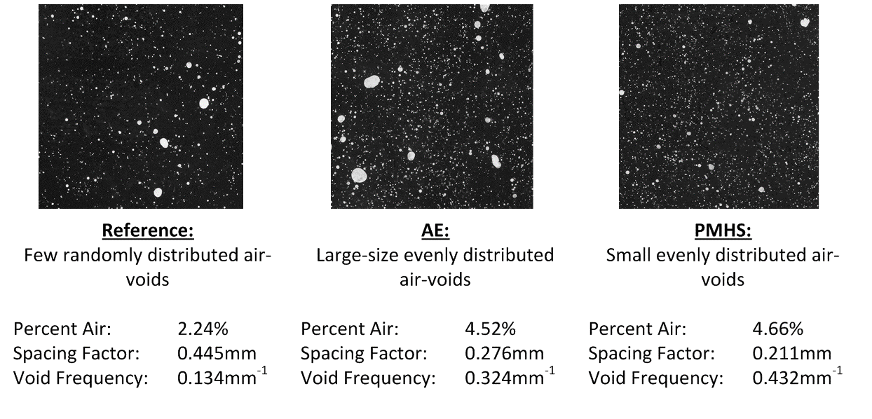
Testing of Admixtures

Slide 28
Results
Specimen ID | w/cm | s/cm | SCM | Emulsion
REF 30 | 0.30 | 0.5 | 50% GGBFS | None
REF 45 | 0.45 | 1.0 | 50% GGBFS | None
E 30 | 0.30 | 0.5 | 50% GGBFS | Single Dose*
E 45 | 0.45 | 1.0 | 50% GGBFS | Single Dose*
RECS 15x12 mm PVA Fibers at a content of 2.75%
0.125 SP content (w/cm=0.3)
0.05 SP content (w/cm=0.45)
* 0.25g of siloxane to 1L of SECC

Slide 29
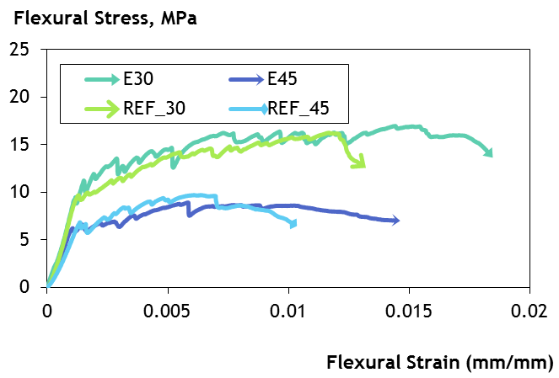
Mechanical Results

Slide 30
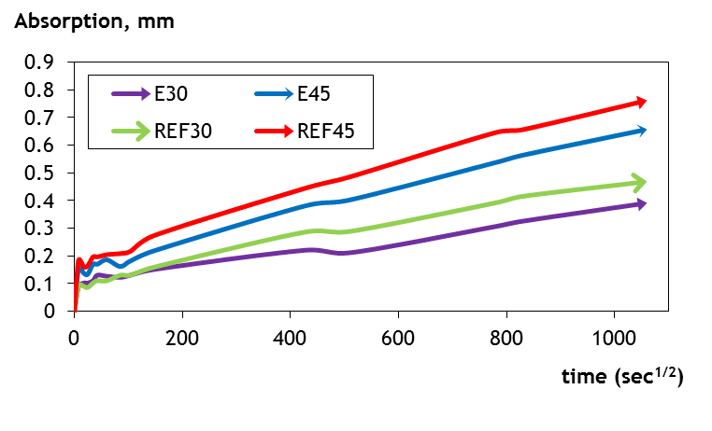
Absorption Results

Slide 31
Freeze-Thaw Testing
Freeze-thaw tests were performed in a modified test procedure:
  Temperatures oscillating between 20°C with 95% relative humidity and -50°C with 0% relative humidity;
  Fresh water and salt water (5% NaCl solution) medium;
  Multiplier of 5 used for number of freeze-thaw cycles.

Slide 32
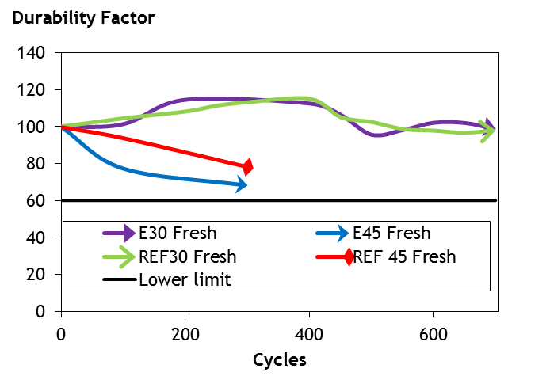
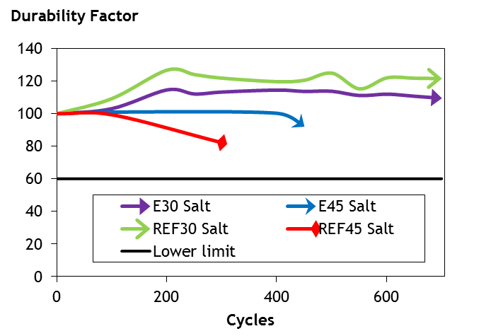
Freeze-Thaw
Results

Slide 33
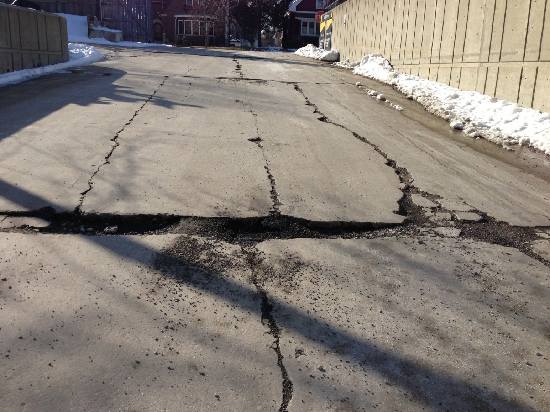
Field Study

Slide 34
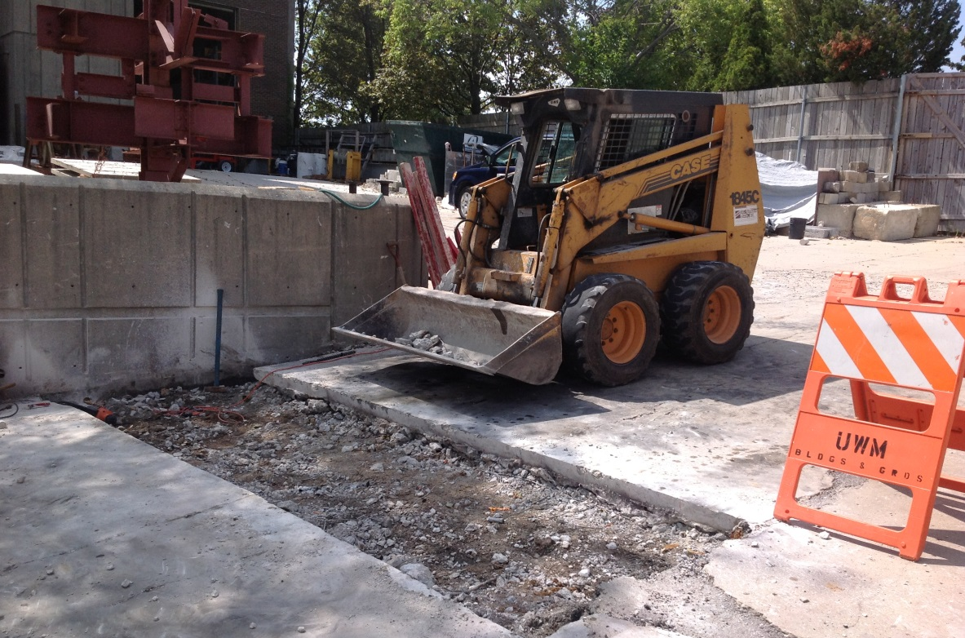
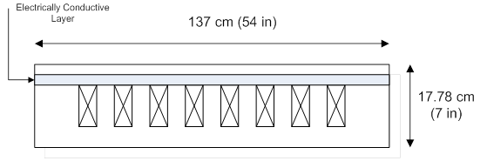
Field Study
Superhydrophobic Admixtures
2.5% by volume PVA fibers
W/CM = 0.32
S/CM = 0.50
5% of cementitious material Silica Fume
45% of cementitious material Blast Furnace Slag

Slide 35
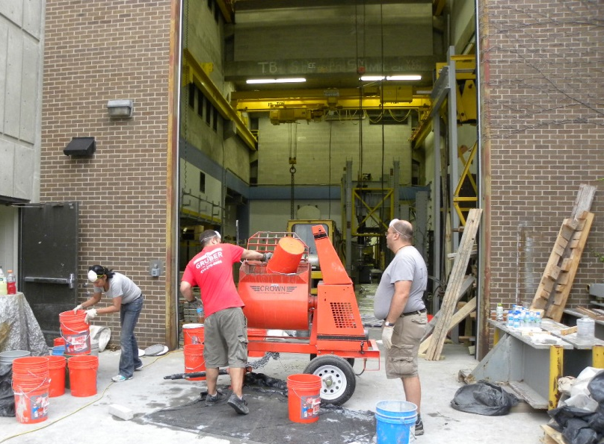
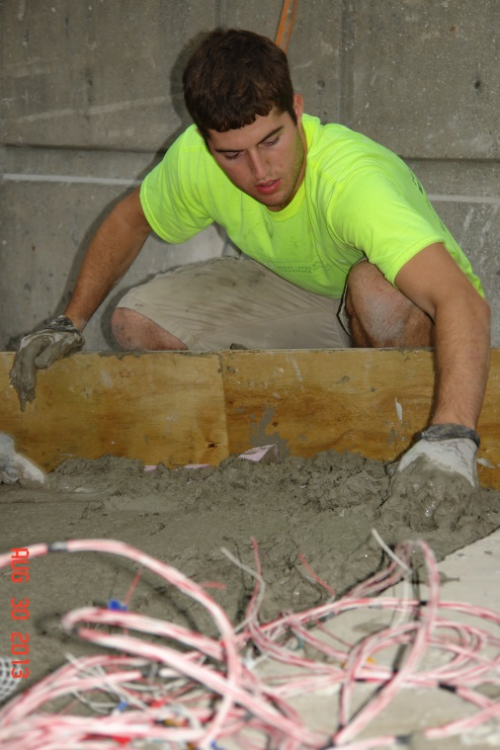
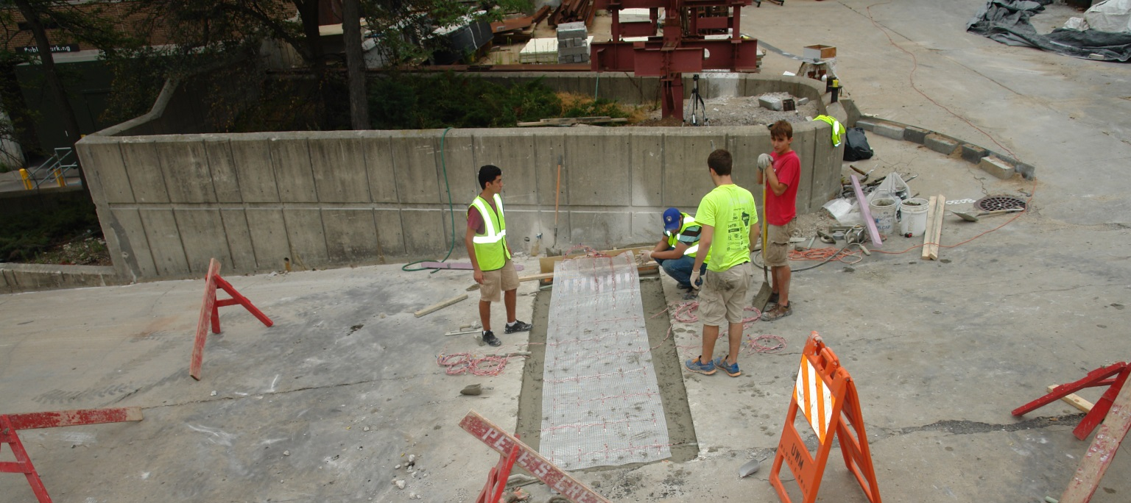

Slide 36
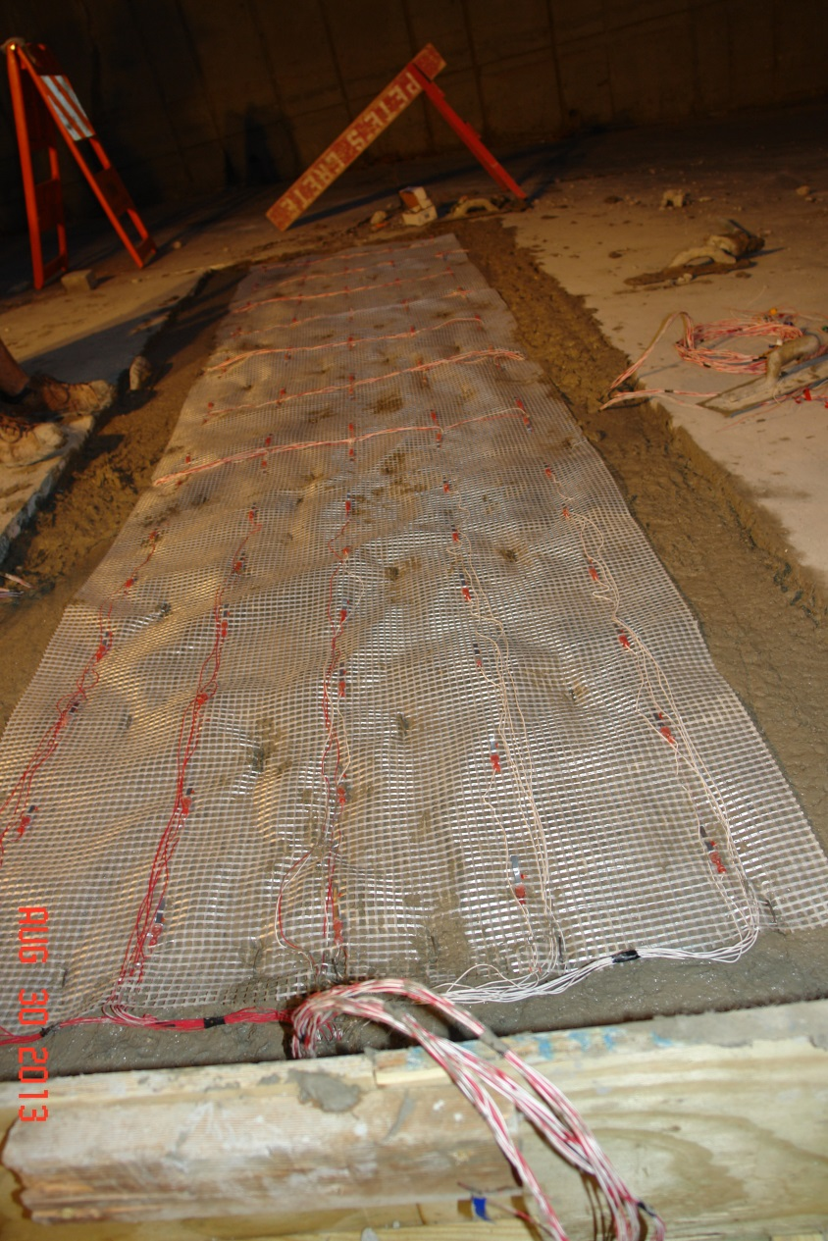
Electrically Conductive Layer
Same composition as fiber reinforced concrete
No Superhydrophobic Admixtures
No Supplementary Cementitious Materials
0.1% by weight of cement Carbon Nano-Fibers
100 stainless steel electrodes evenly distributed throughout slab

Slide 37
Electrically Conductive Layer:
How it works
System will measure resistivity of concrete between embedded electrodes.
  Measurement is a unique method that forces a very small amount of current through the concrete using very little power
When micro cracks form in the concrete (which is normal) the resistance in the concrete increases and that increase is measurable
When a force is applied to the concrete and the structure bends these cracks get bigger and the resistance goes up more

Slide 38
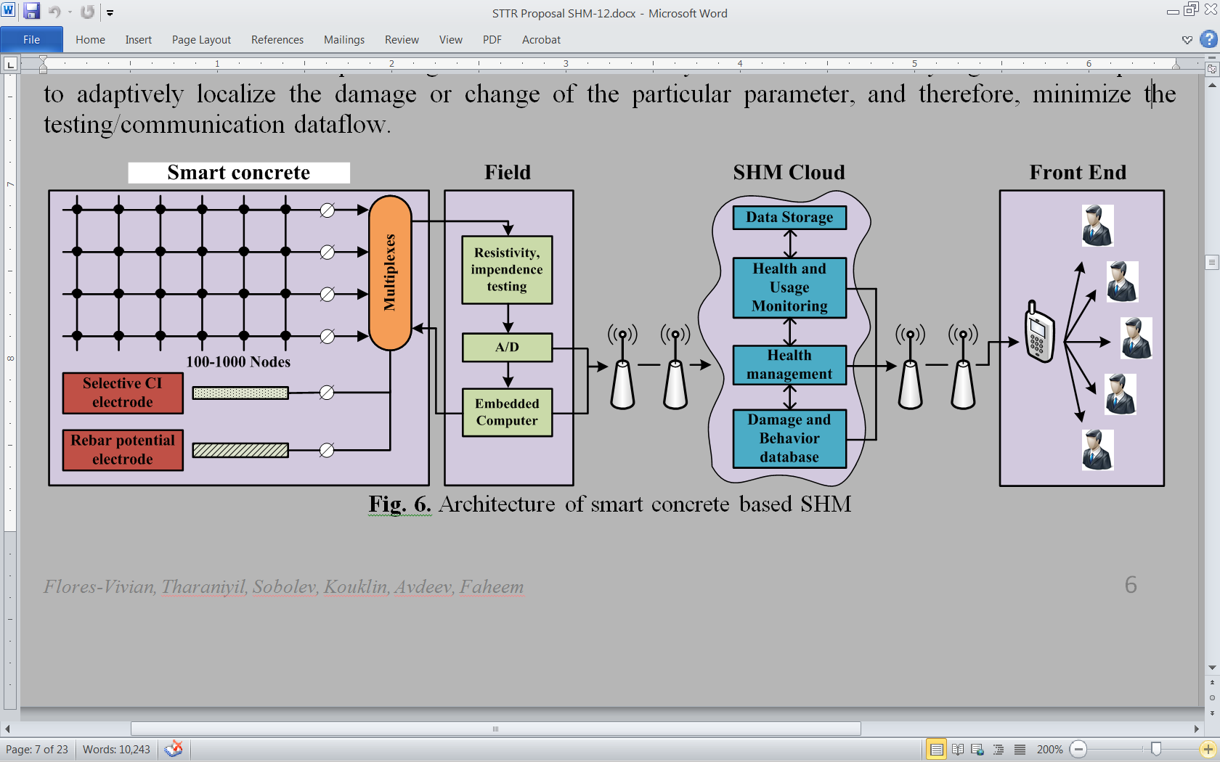
Electrically Conductive Layer

Slide 39
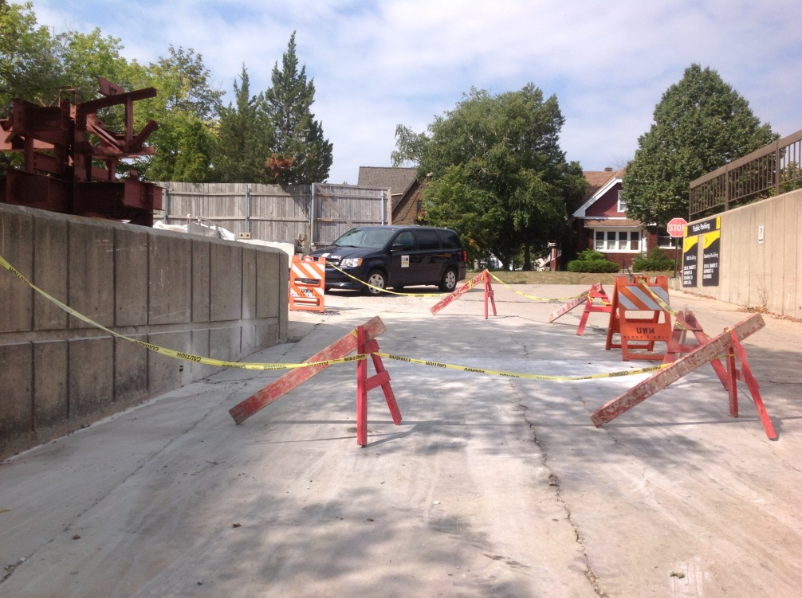
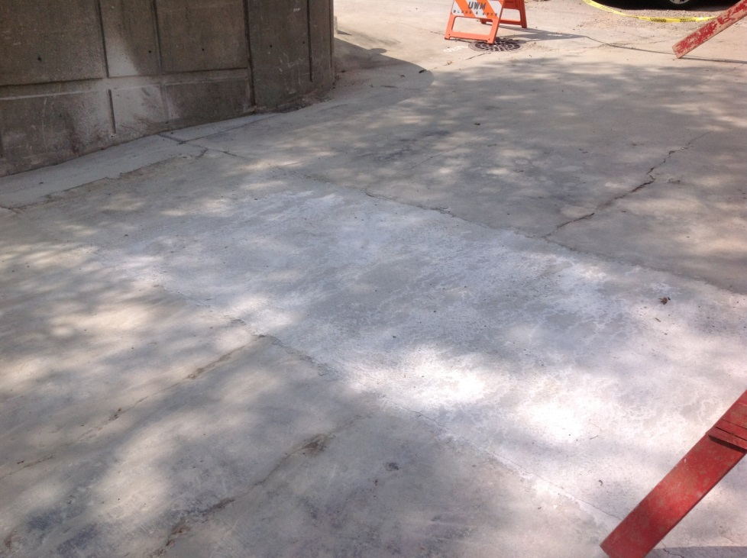
Final Product
Two Surface Coats of Superhydrophobic Emulsions
Future Work:
Resistivity Readings

Slide 40
CONCLUSIONS
The use of superhydrophobic admixtures to fiber-reinforced composites provides improved durability by:
  Demonstrating very little reduction in compressive strengths;
  Providing improved flexural response by introducing artificial flaws to initiate multi-cracking;
  Providing a controlled or “desired” air void structure;
  Providing exceptional freeze-thaw resistance;
  Decreasing absorption and permeability.

Slide 41
Future Work
  Improve the cement and aggregate matrix of fiber reinforced composites with superhydrophobic admixtures to create an ultra-durable material
  Test contact angle and wear resistance of superhydrophobic surface applications
  Perform tests on electrically conductive fiber reinforced concrete

Slide 42





Acknowledgments
CFIRE
WisDOT
NSF
UWM RGI & UWM Foundation
WE Energies
Lafarge
Cemex
Handy Chemicals
Kuraray

Slide 43
Contact Information:
Scott Muzenski swm@uwm.edu
Konstantin Sobolev sobolev@uwm.edu
Thank You!!
Questions?

