Slide 1
Alaska concrete
2014

Slide 2
Concrete intersection
Concrete Producers offer to pay difference between asphalt and concrete intersection
Concrete Products Association annual winter meeting
Alaska Concrete Alliance
Alaska Concrete Alliance Summit
Alaska Chapter of the American Concrete Institute

Slide 3
Minnesota & old seward

Slide 4
O’malley & old seward

Slide 5
Uaa & providence bus pull out

Slide 6
Load distribution

Slide 7
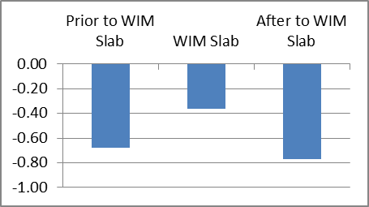
Seward Highway 5 year old SMA & PCC
Seward Highway northbound
Mix |  | Average Rut Depth (in.)
2003 SMA | Prior to WIM Slab | -0.68
2003 PCC | WIM Slab | -0.36
2003 SMA | After to WIM Slab | -0.77
Seward Highway southbound
Mix |  | Average Rut Depth (in.)
2003 SMA | Prior to WIM Slab | -0.74
2003 PCC | WIM Slab | -0.30
2003 SMA | After to WIM Slab | -0.91

Slide 8
Glenn Highway northbound 5 Year old PCC & SMA
Glenn Highway northbound
Mix |  | Average Rut Depth (in.)
2003 SMA | Prior to WIM Slab | -0.29
2003 PCC | WIM Slab | -0.13
2003 SMA | After to WIM Slab | -0.47

Slide 9
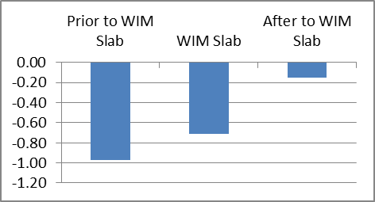
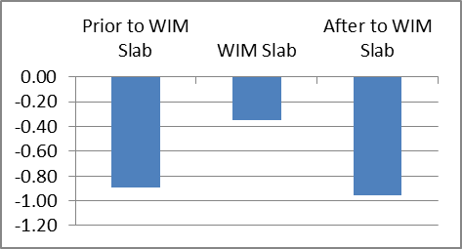
Minnesota south 9 year old SMA & PCC Minnesota North 8 year old sma & pcc
Minnesota Drive northbound
Mix |  | Average Rut Depth (in.)
2000 SMA | Prior to WIM Slab | -0.97
2000 PCC | WIM Slab | -0.71
2008 HMA* | After to WIM Slab | -0.15
Minnesota Drive southbound
Mix |  | Average Rut Depth (in.)
1999 SMA | Prior to WIM Slab | -0.90
1999 PCC | WIM Slab | -0.35
1999 SMA | After to WIM Slab | -0.96

Slide 10
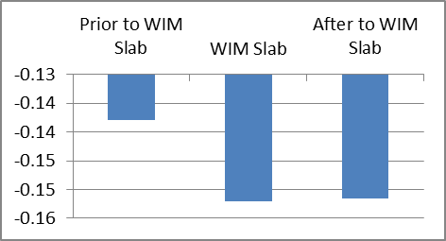
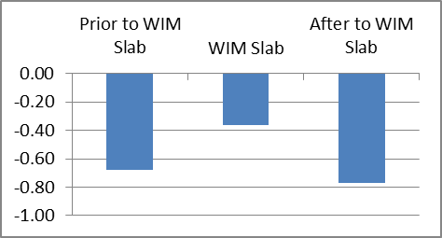
Tudor road 3 year tV 5 year old pcc
Tudor Road eastbound
Mix |  | Average Rut Depth (in.)
2005 Type VH* | Prior to WIM Slab | -0.14
2003 PCC | WIM Slab | -0.15
2005 Type VH* | After to WIM Slab | -0.15
* Mix with imported hard aggregates
Tudor Road westbound
Mix |  | Average Rut Depth (in.)
2005 Type VH* | Prior to WIM Slab | -0.23
2003 PCC | WIM Slab | -0.15
2005 Type VH* | After to WIM Slab | -0.30
* Mix with local aggregates

Slide 11
Concrete for Transportation

Slide 12
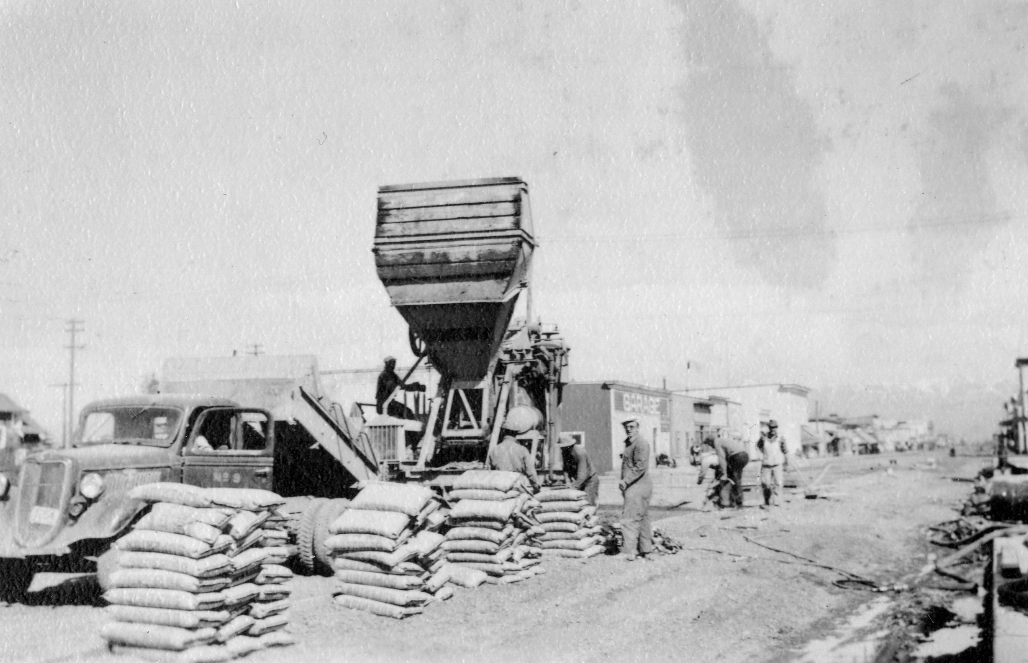

Slide 13
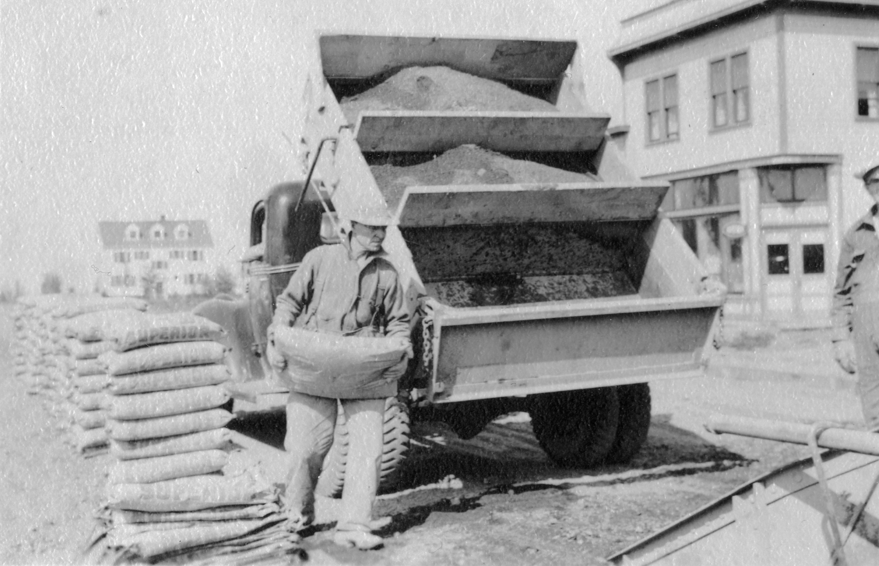

Slide 14
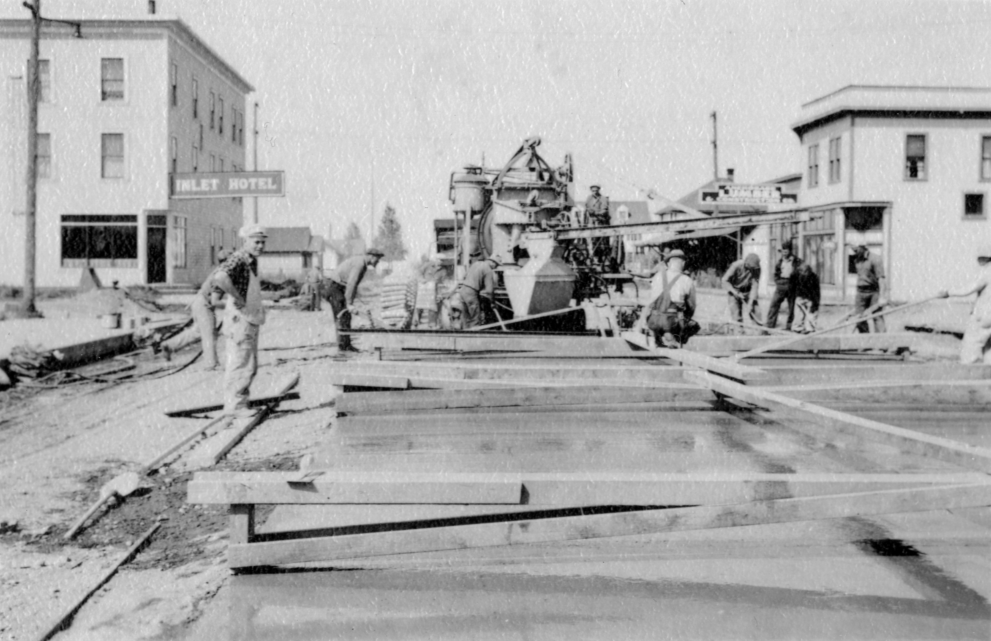

Slide 15
