Slide 1
The Economic Implications of Changing Demographics in Alaska Disadvantaged Business Enterprise and Subcontractors Conference
March 17, 2022
Ralph Townsend
Professor of Economics

Slide 2
Thanks for Northrim Bank support since 2008 for ISER’s “Investing for Alaska’s Future” project.
Acknowledge work of demography staff at AK Dept of Labor and Workforce Development: David Howell, Eric Sandberg, Liz Brooks
ISER publications and presentations are solely the work of individual authors and should be attributed to them, not to ISER, the University of Alaska Anchorage, or the research sponsors.

Slide 3
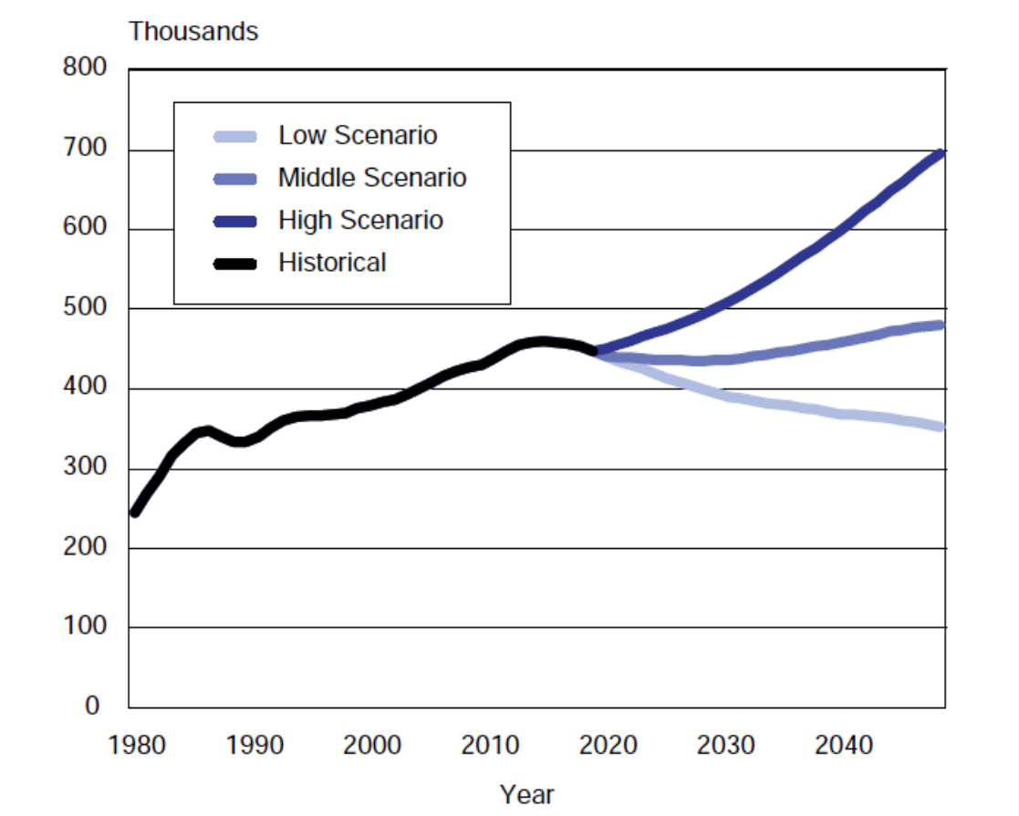
Alaska Population Ages 20-64 1980-2045
Source: AK DOLWD

Slide 4
Demographics Matter!
Alaska ratio
Year male to female
1900 2.58
1950 1.61
1970 1.18
2016 1.06
Source: US Census

Slide 5
The big change: We’re getting older, and quickly.
% of population over 65
Year US Alaska
1980 11 % 3 %
1990 13 % 4 %
2000 12 % 5 %
2010 13 % 7 %
2017 16 % 11 %
2030 20 % 17 %
Source: AK Dept. of Labor and Workforce
Development

Slide 6
Under-18 Population, Alaska
Source: US Census
Notes:
Alaska has already gone through a major demographic shift in its younger population. Non-Hispanic whites are only one-half of those under-18 in Alaska.

Slide 7
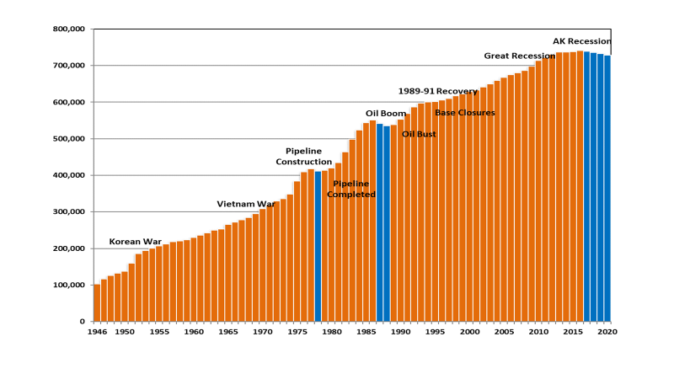
Alaska’s Population
Source: David Howell, DOLWD

Slide 9
Alaska Population Ages 20-64 1980-2045
Source: AK DOLWD

Slide 10
Net Migration for Alaska
Year | Net Migration | Population change
2010-11 | 639 | 8,489
2011-12 | 1,285 | 8,532
2012-13 | -1,785 | 5,547
2013-14 | -6,963 | 501
2014-15 | -6,296 | 733
2015-16 | -3,970 | 2,851
2016-17 | -8,043 | -1,717
2017-18 | -9,509 | -3,553
2018-19 | -7,888 | -2,633
2019-20 | -8,873 | -3,831
2020-21 | -4,398 | 932
Source: AK DOLWD

Slide 11
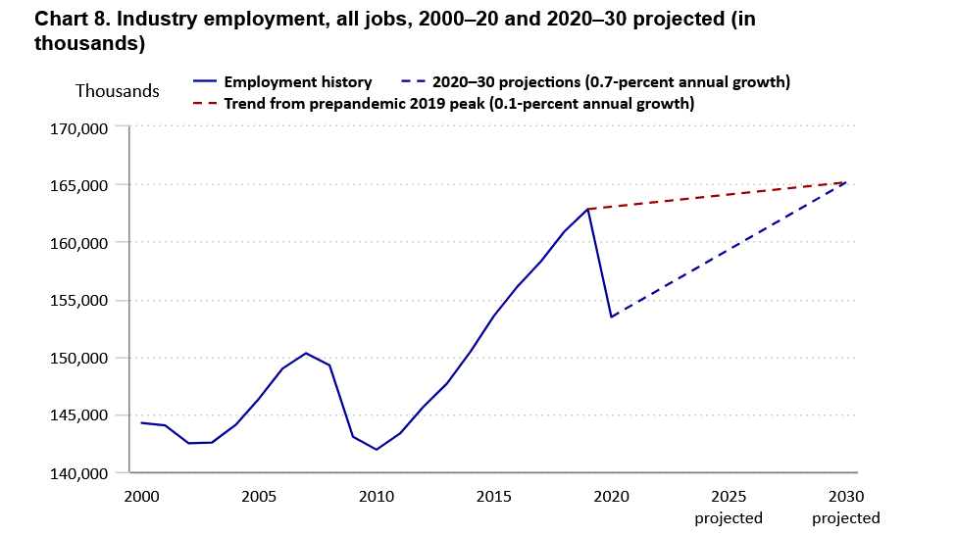
Projected Total US Employment
Source: BLS 2021

Slide 12
Is pandemic a demographic “tipping point”?
US population 16-64 fell 0.1% in 2020.
Between 2007-2017, 80% of counties had decline in 25-54 age group
To 2060, migration + births to foreign born mothers > total growth

Slide 13
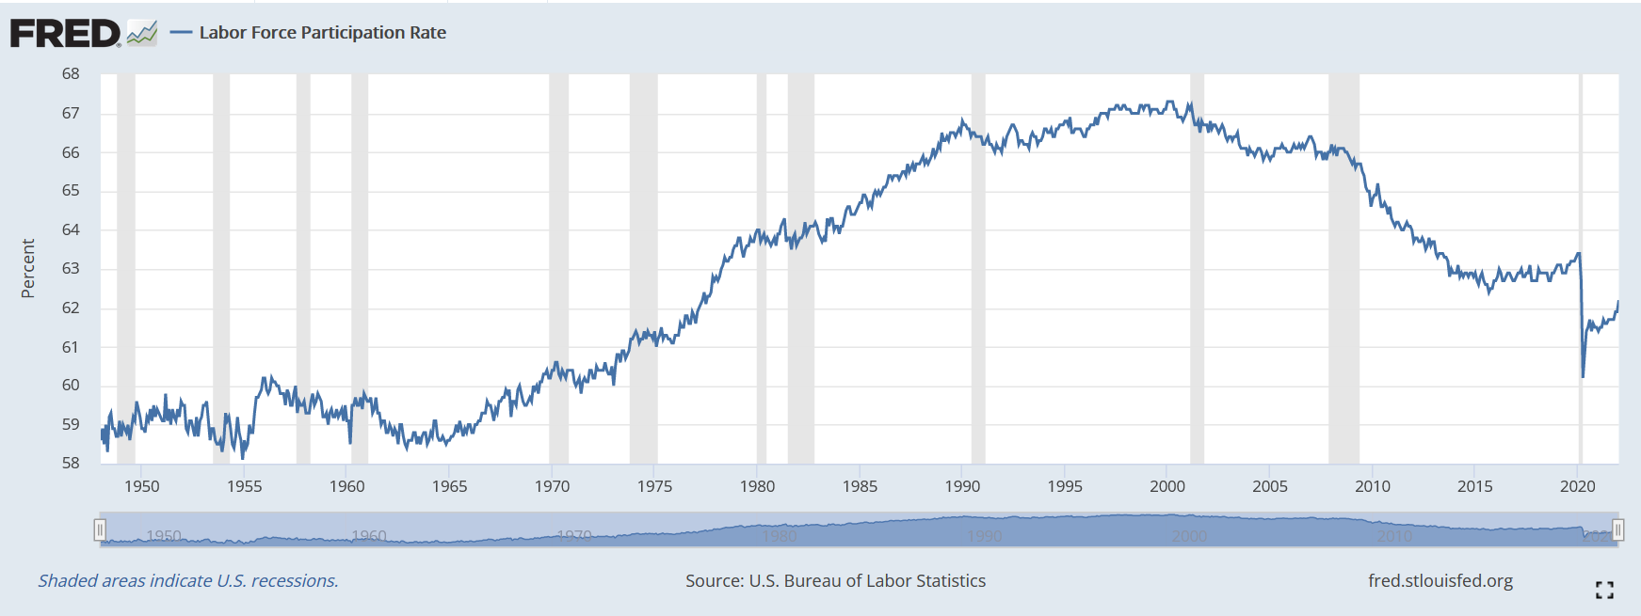
Labor Force Participation

Slide 14
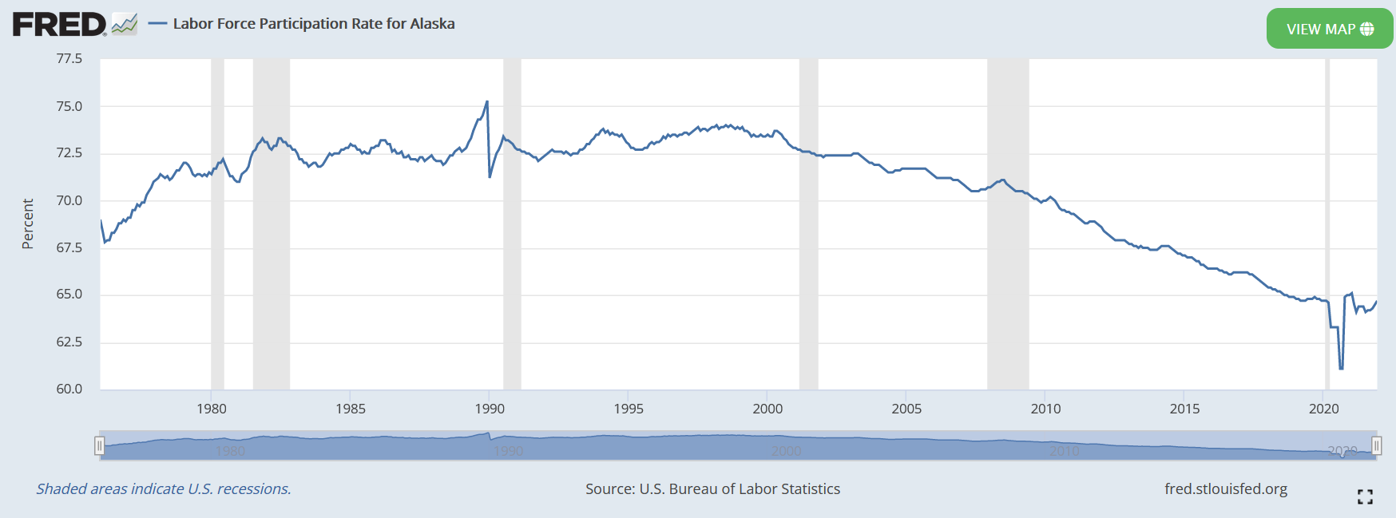
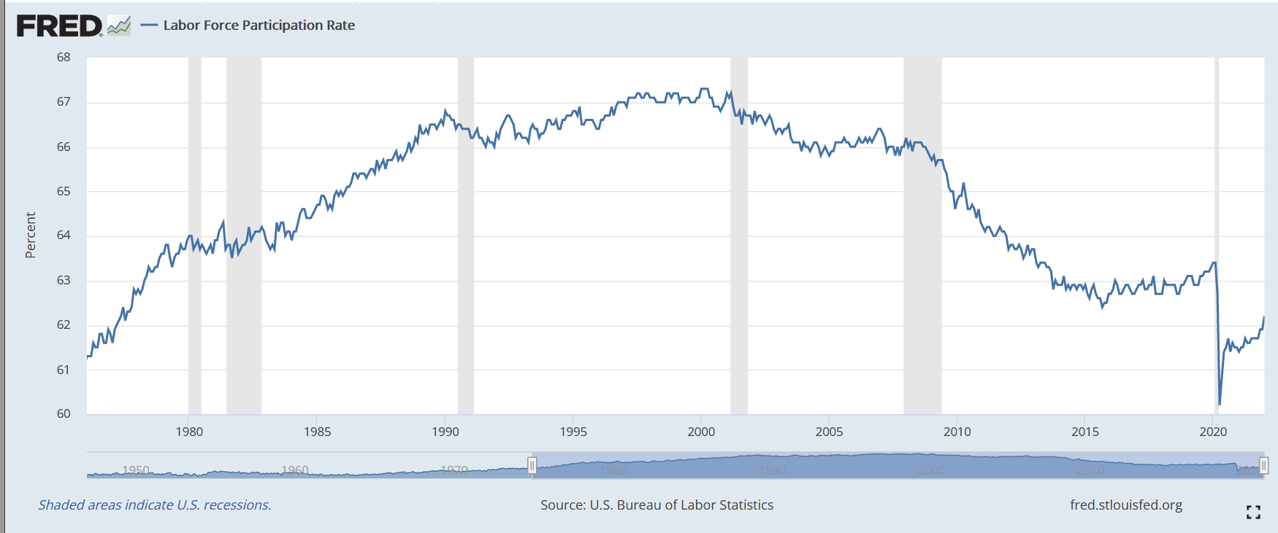

Slide 15
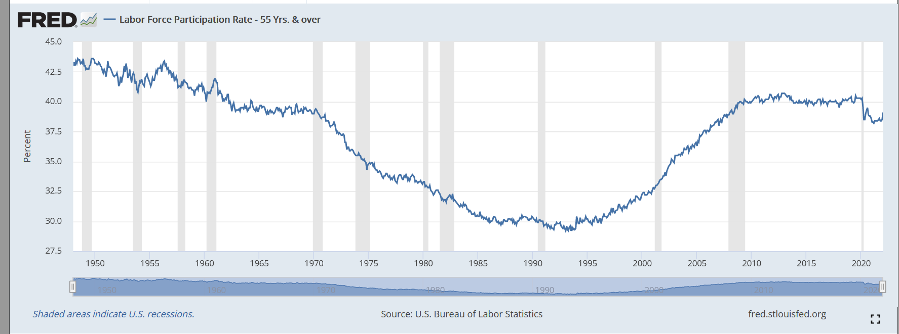
Labor Force Participation--55+

Slide 16
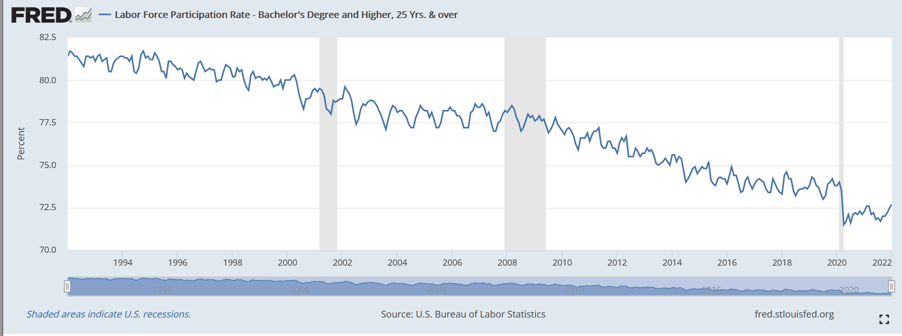
Labor Force Participation BA/BS degree or higher

Slide 17
Long term issues: Increasing the labor pool in the US
Immigration
Childcare and pre-K education
Education: K-12 and post-secondary

Slide 18
Long term issues: Increasing the labor pool in Alaska
Education: K-12 and post-secondary
Childcare and pre-K education
Immigration (incl. student visas)
Getting off the oil price roller coaster
Infrastructure
Attractive lifestyle features

Slide 19
Long term issues: Adjusting to tighter labor markets
Getting/keeping workers in workforce
Investments to increase productivity

Slide 20
References
Alaska Dept. of Labor and Workforce Development (2020).
“Alaska Population Projections, 2019-2045.”
https://live.laborstats.alaska.gov/pop/projections/pub/popproj.pdf
Federal Reserve of St. Louis. FRED data on Labor Force
Participation. https://fred.stlouisfed.org/categories/32443
Guettabi (2019). “A simple decomposition of Alaska’s
labor force participation rate.” https://iseralaska.org/publications/?id=1788

Slide 21
The Economic Implications of Changing Demographics in Alaska

