Slide 1
Solicitations & Finding Work
March 2022

Slide 2
Central Region Contacts
Sharon L. Smith, P.E., AK DOT&PF Contracts
Kathie Bridenbaugh, AK DOT&PF Contracts

Slide 3
Central Region’s Contracts Section Staff
Chief Contracts Officer
Commissioner’s Office
Chief of Contracts
PSA Unit Supervisor
Review Engineer
Review Engineer
Procurement Specialist II
Procurement Specialist II
Administrative Assistant II
Procurement Specialist II
Office Assistant II
Procurement Specialist III
Procurement Specialist II

Slide 4
Introduction to PSA Section – What We Do
Assist Contracting Officers
Assist Project Managers
Assist Consultants
RFPs, PSAs, invoice payments, past proposals, debriefings, upcoming work

Slide 5
What is Construction Procurement?
As defined by the State of Alaska
Construction is the process of building, altering, repairing, maintaining, improving, or demolishing a public highway, structure, building, or other public improvement of any kind to real property other than privately owned real property leased for the use of agencies.
It includes services and professional services relating to planning and design required for construction.
It does not include the routine operation of public improvement to real property nor does it include the construction of public housing; all delegations for construction must be secured in writing from DOT&PF.

Slide 6
What is Professional Service?
“Professional Services” means professional, technical, or consultant services that are predominantly intellectual in character, result in the production of a report of the completion of a task, and include analysis, evaluation, prediction, planning, or recommendation. Professional services for construction related services are predominately qualifications based.
Example:
Aerial Photography – professional service would hire a contractor to fly an area, manipulate a photo or AutoCAD drawing, and provide a report. Professional Services Unit would assist.
A supply purchase is buying a map right off the shelf. The Supply Section would assist.

Slide 7
What, How, & Where are the State Procurement Opportunities
DOT Procurement and Contracting:
Requests for Proposals
Qualifications Based Selections
Where to fine RFPs
Letter of Agreement – proposals $10,000 or less
Small Procurements, less than
$200,000
State & Federally Funded
Competitive Sealed Proposals, greater than
$200,000
State & Federally Funded
RFP Advertising Schedule
Central Region (PDF)
Northern Region (PDF)
Obtaining RFP E-Documents
About RFPs
Large Procurement Manuals
Small Procurement Manuals

Slide 8
Qualifications Based Selections
Brooks Act :
The Brooks Act (Public Law 92-582), also known as Qualifications Based Selection (QBS), which was enacted on October 18, 1972, establishes the procurement process by which the architects and engineers (A/Es) are selected for design contracts with federal design and construction agencies. The Brooks Act establishes a qualification-based selection process, in which contracts for A/Es are negotiated on the basis of demonstrated competence and qualification for the type of professional services required at a fair and reasonable price. Under QBS procurement procedures, price quotations are not a consideration in this selection Process.
Alaska Statute 36.30.270 :
(a) Notwithstanding conflicting provisions of AS 36.30.100 – 36.30.260, a procurement officer shall negotiate a contract for the agency with the most qualified and suitable form or person of demonstrated competence for architectural, engineering, or land surveying services. The procurement officer shall award a contract for those services at the fair and reasonable compensation as determined by the procurement officer, after consideration of the estimated value of the services to be rendered, and the scope, complexity, and professional nature of the services. http://www.akleg.gov/basis/statutes.asp#36.30.260

Slide 9
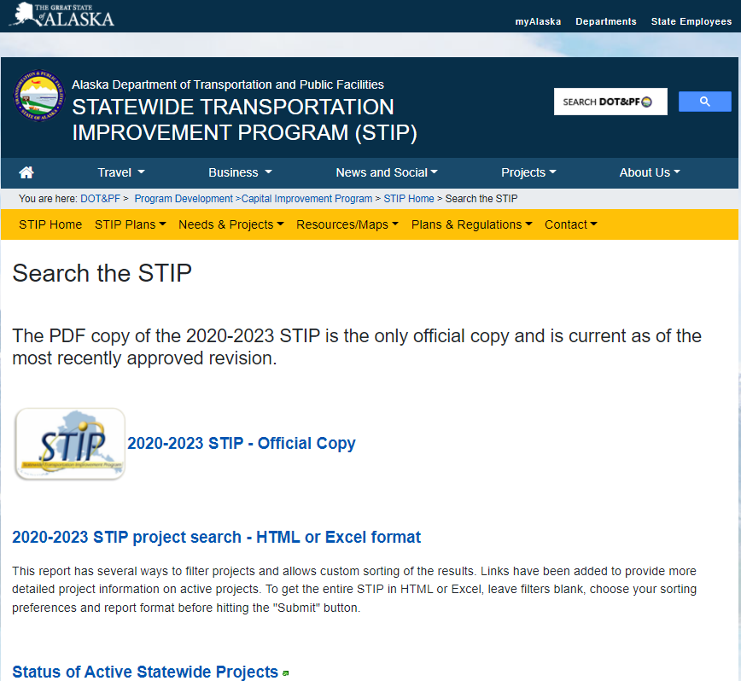
Where to Search for Upcoming or Advertised Solicitations
DOT&PF Website:
http://dot.alaska.gov/procurement/index.shtml
Online Notices:
https://aws.state.ak.us/OnlinePublicNotices/Default.aspx
STIP:
http://www.dot.alaska.gov/stwdplng/cip/stip/search.shtml

Slide 10
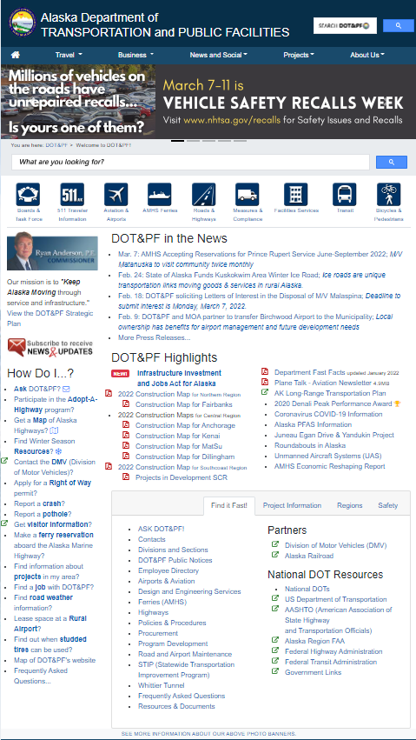
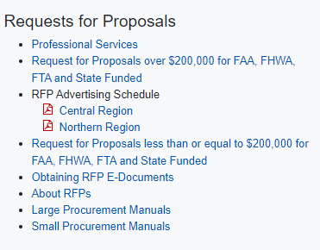
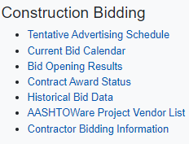
AK DOT&PF Procurement Page
DOT&PF Homepage
DOT&PF Procurement and Contracting

Slide 11
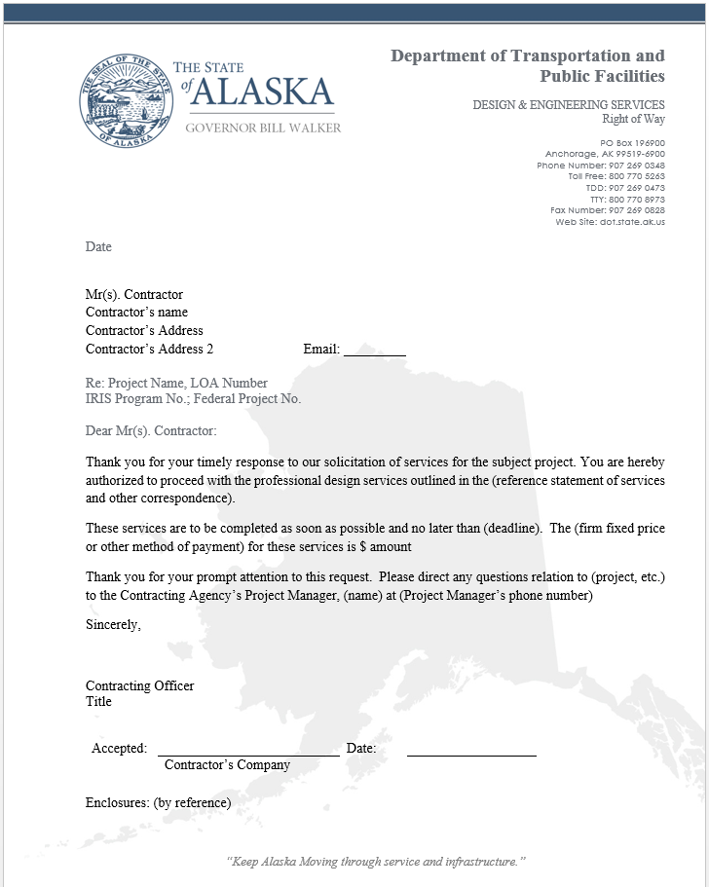
Letter of Agreement ($10,000 or less)
Chapter 1, PSA Manual
Proposals
Oral solicitation is sufficient. If proposals are easy to obtain and require only minimal amounts of time and effort, then three proposals would be reasonable. However, contracts of a lower dollar value require less solicitation effort than those approaching the $10,000 plateau.
A Letter of Agreement is prepared and signed by the Contracting Agency and the Contractor.

Slide 12
Small Procurements (>$10,000 <$200,000)
Chapter 2, PSA Manual
Proposals
Proposals are obtained by using the Small Procurement RFP, and are most commonly advertised on the DOT&PF Homepage, with a minimum of 3 day posting. For federally-funded projects, Project Managers are required to contact any DBE firms that can provide the specific services and let them know that the RFP has been advertised.
Proposal Evaluation
The Project Manager writes an evaluation report that includes evaluation of all proposing firms, then identifies the top three most qualified offerors. Contracting Officer selects the Contractor. After negotiations are complete, the Agreement is prepared and signed.

Slide 14
Competitive Sealed Proposals
Greater Than $200,000
Chapter 3, PSA Manual
Proposals
The RFP package will by advertised on the DOT&PF Homepage and the State On-Line Public Notices site.
Minimum 21 day posting, unless otherwise approved by the Contracting Officer.
Review Part A of the RFP for information relating to current policies on receipt of proposals, available supplemental information, and specific contract terms that will be implemented.
Proposal Evaluation
A responsive proposal requires current professional registrations, and an AK Business License for State-funded projects where an offeror is claiming AK Offeror Preference.
Responsive proposals are evaluated and scored by a committee. A meeting is held to discuss the ratings and any concerns or comments that the evaluators may have.
Contractor Selected for Negotiation
The Contracts Section will prepare a Notice of Intent to Negotiate for the Contracting Officer’s signature. This will be sent to all proposers. Details concerning the evaluation are confidential until after the Intent to Award is signed.

Slide 18
Formal Competitive Sealed Proposals – continued
Technical and Price or Cost Analysis/Audit of Contractor’s Records
The Contracts Section will issue a Pre-negotiation Requirements Letter to the selected Contractor. They will obtain and check validity of the Contractor’s responses to ensure that the Contractor and Subcontractors are “responsible.”
Verification that all required insurance is current and in place.
If Contractor and/or Subcontractor’s cumulative involvement is estimated to be over $250,000, an audit may be required. Audits ensure acceptable accounting system, establishes fair and reasonable labor rates, indirect cost, equipment prices, and assures eligibility documentation requirements.
The System for Award Management (SAM) is checked for suspension and disbarment actions and eligibility status for Prime Contractor and Subcontractors.
Negotiation
Negotiate services, schedule, price and method(s) of payment.
Perform a Technical Price or Cost Analysis of the price proposal.

Slide 19
Formal Competitive Sealed Proposals – continued
Notice of Intent to Award
Once the final price proposal has been accepted, the Contracts Section will prepare a Notice of Intent to Award (ITA) for the Contracting Officer’s signature. This will be sent to all proposers and will start the 10-day protest period.
After the Notice of Intent to Award, all proposals and Agency files (except for agreed upon specific proprietary information) are public information.
Written Contract
A standard written Professional Services Agreement is prepared and routed for signatures. Following execution, the Contracting Agency issues a Notice to Proceed.

Slide 20
Characteristics of Successful Proposals
Knowledgeable of the project; tailored proposal identifies and addresses specific challenges and issues.
Strong technical team with applicable experience.
Answer ALL the criteria and ALL sub-parts to each criterion.
Clearly written and factually correct.
Well organized, format counts.

Slide 21
Quality Control
If proposing on a State-funded project as a Prime Contractor, make sure your Alaska Business License is current.
The name listed on the proposal must be the same as your business license.
Verify professional licenses are current for all required disciplines.
Spell check, proofread, eliminate errors from cut and paste from past proposals.
Check telephone numbers and emails for accuracy.
Get permission from the references you use.
Verify name of project manager is correct.
Do not exceed the specified number of pages – it will change from time to time depending on the Project Manager and the project.
Do not wait until the last minute.

Slide 22
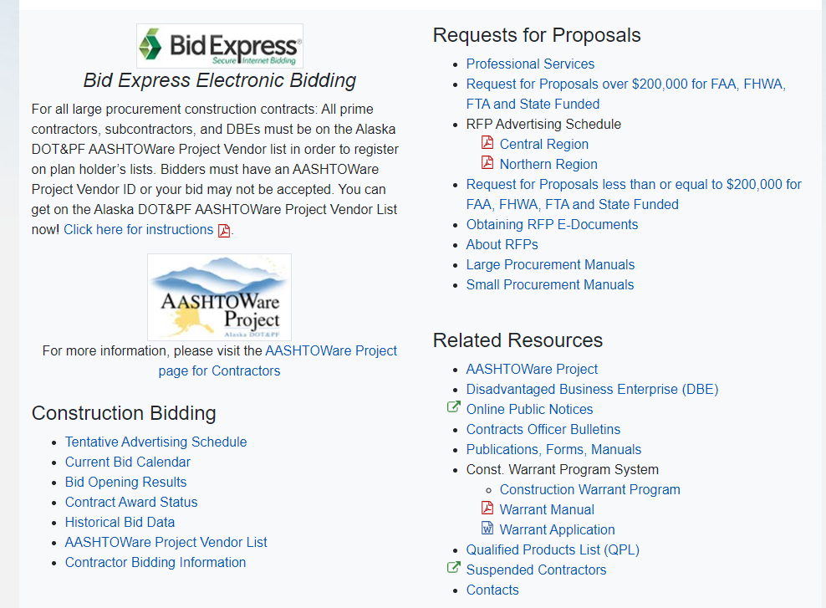
Construction Contracting

Slide 23
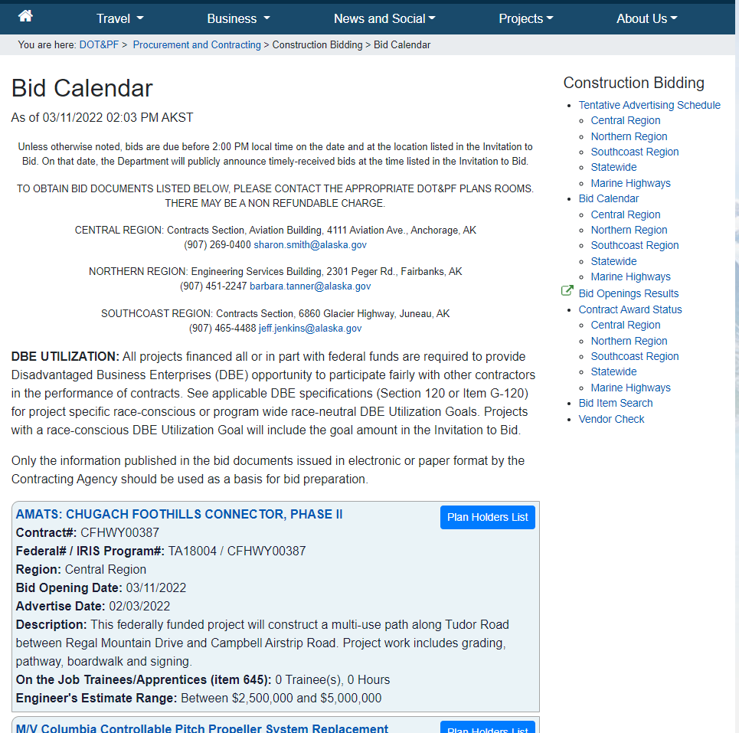

Slide 24
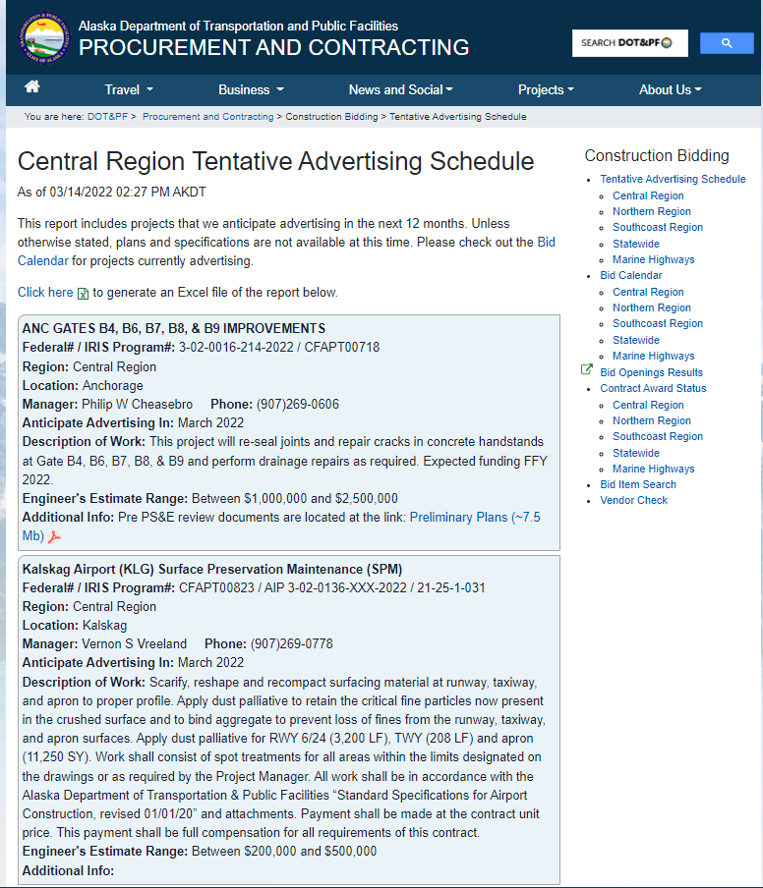

Slide 25
QUESTIONS?

