Slide 1
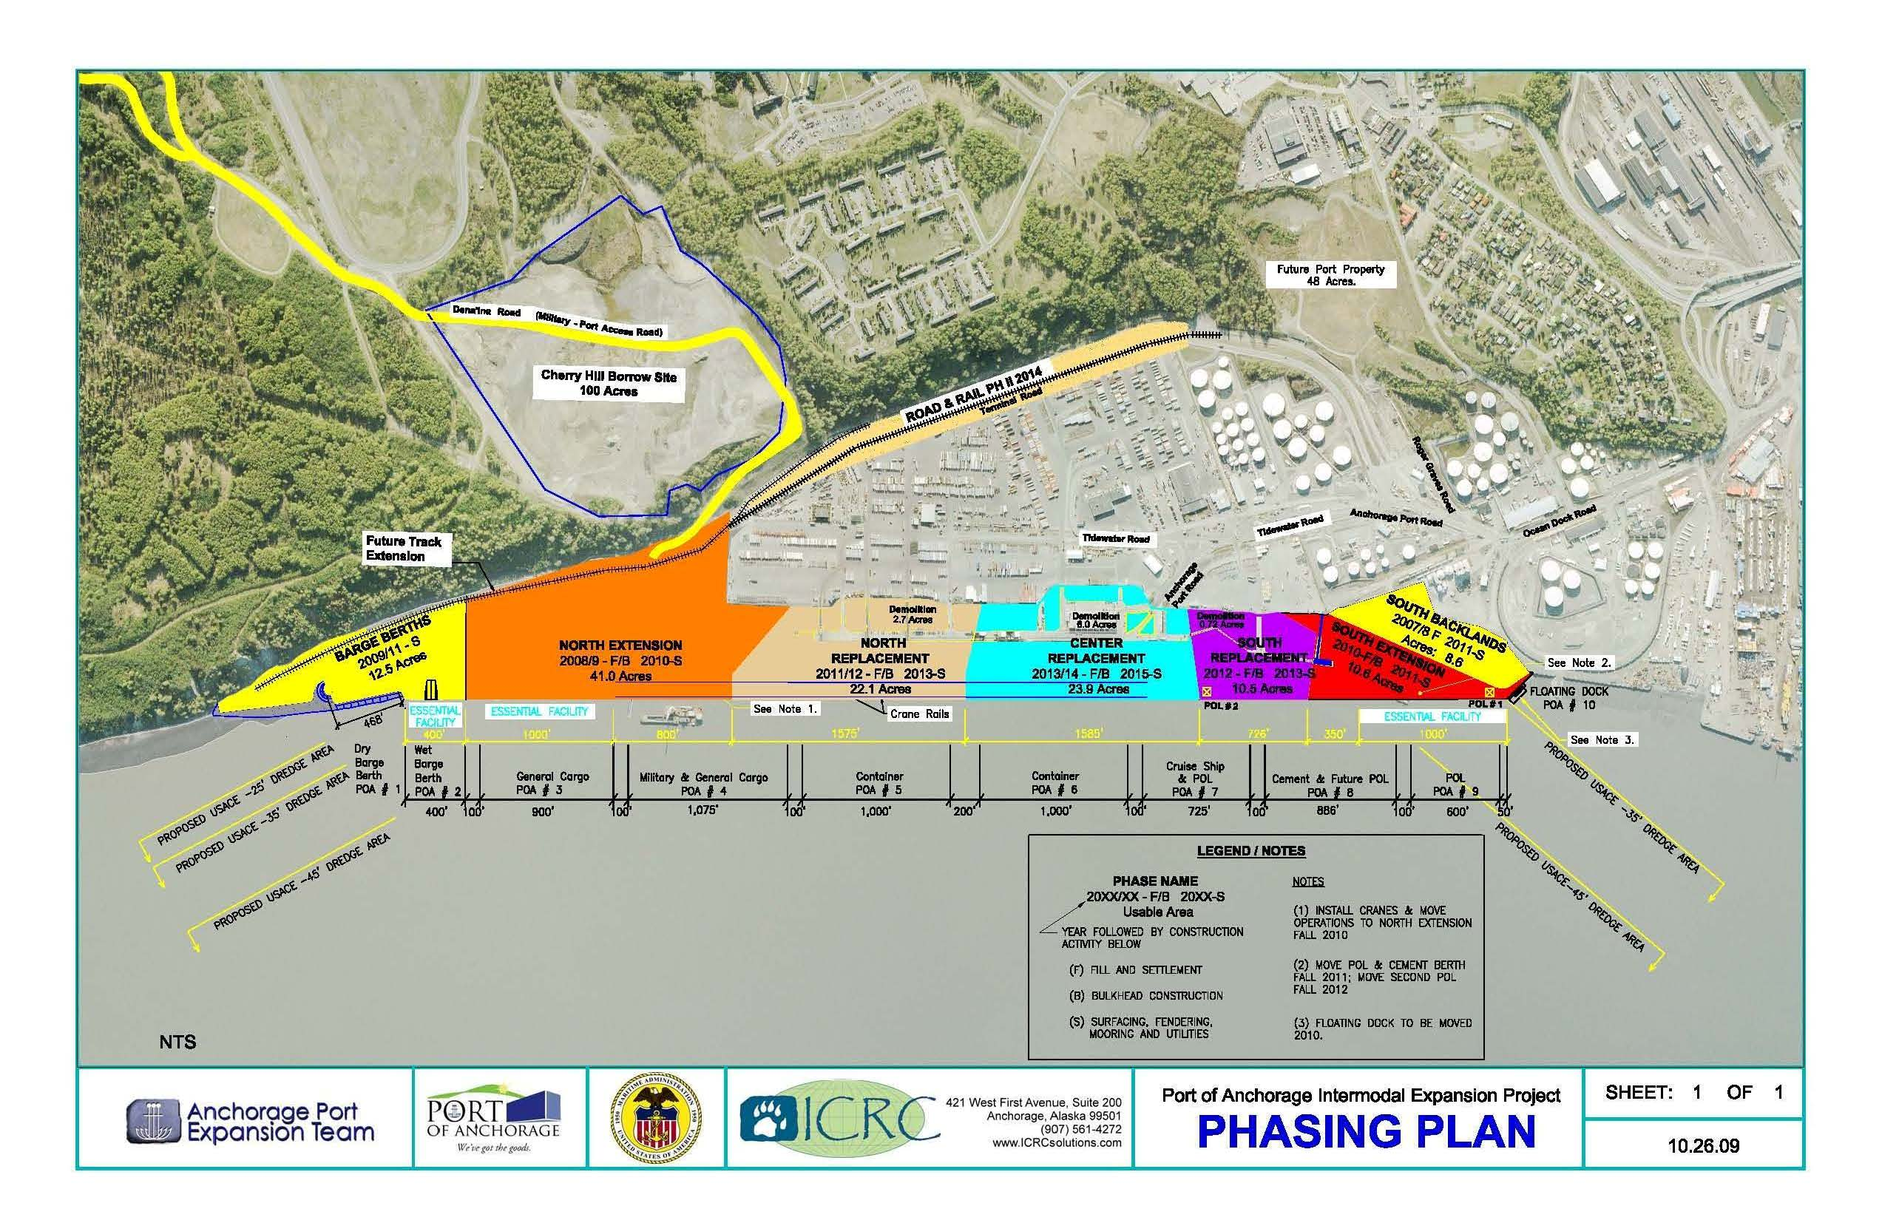
PORT OF ANCHORAGE
"THE BIG PICTURE"

Slide 2
PORT OF ANCHORAGE

